Slide 1
Texas Statewide Multimodal Transit Plan
Transit Forward
FEBRAUARY 22, 2024
Caroline A Mays, AICP
Director of Planning and Modal Programs

Slide 2
Presentation Overview
TxDOT’s Planning and Modal Programs
Texas Statewide Multimodal Transit Plan
What, Why, and Why Now
Vision, Emphasis Areas, and Timeline
Existing Conditions and Trends
Public/Stakeholder Outreach and Engagement
Next Steps

Slide 3
TxDOT’s Planning and Modal Programs

Slide 4
TxDOT’s Organizational Structure
TRANSPORTATION COMMISSION
Effective 11/17/2022
Compliance
Chief Audit & Compliance Officer
Internal Audit
Chief of Staff
Executive Director
Director General Counsel
Deputy Executive Director Planning & Administration
Deputy Executive Director Program Delivery
Civil Rights
Chief Engineer
Occupational Safety
Director Communications & Customer Service
Director Strategy
& Innovation
Government Affairs
Chief Administrative Officer
Director Planning & Modal Programs
Director District Operations
Director Engineering & Safety Operations
Director Project Development
Chief Financial Officer
Chief Information Officer
Communications
Research & Technology Implementation
Contract Services
Aviation
Abilene
Bryan
Houston
Pharr
Bridge
Alternative Delivery
Financial Management
Information Technology
Travel Information
Fleet Operations
Maritime
Amarillo
Childress
Laredo
San Angelo
Construction
Design
Project Finance, Debt & Strategic Contracts
Strategic Planning
Atlanta
Corpus Christi
Lubbock
San Antonio
Human Resources
Public Transportation
Materials & Tests
Environmental Affairs
Toll Operations
Austin
Dallas
Lufkin
Tyler
Procurement
Transportation Planning & Programming
Beaumont
El Paso
Odessa
Waco
Traffic Safety
Professional Engineering Proc. Services
Support Services
Rail
Brownwood
Fort Worth
Paris
Wichita Falls
Right of Way
Yoakum
Transportation Programs

Slide 5
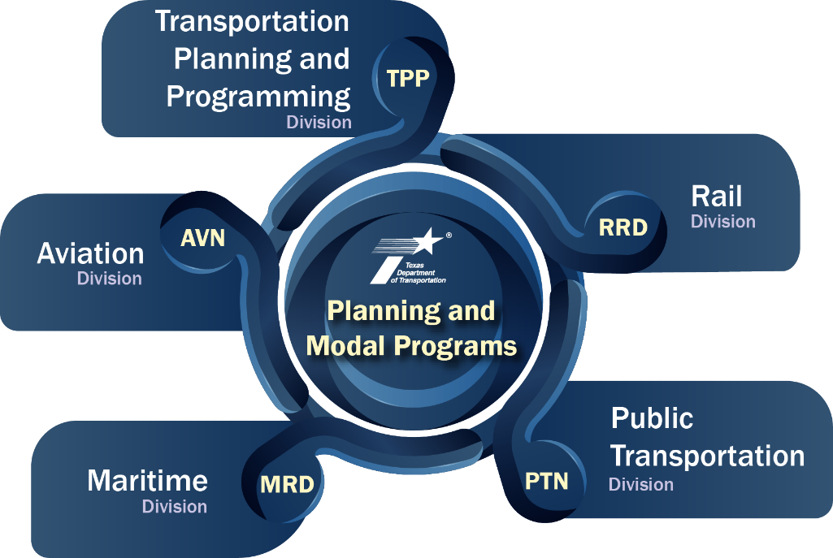
Overview of TxDOT’s Planning and Modal Programs
Core Functions
Multimodal Planning & Programming
Project Development
Federal & State Requirements
Funding & Grants Management
Advisory Committees
Stakeholder Engagement
Data & Performance Management
TxDOT District Support
TxDOT Division Support
TxDOT Administration & Commission Support
Image by Freepik

Slide 6
Multimodal Transportation Planning and Programs at TxDOT
10-yr. UTP & 4-yr. STIP
Agency Strategic Plan
CONNECTING TEXAS 2050
Statewide Long-Range Transportation Plan
Texas Multimodal People Movement Plans
Texas Multimodal Goods Movement Plans
Statewide Active Transportation Plan
Texas Freight Mobility Plan
Truck Parking Plans
Statewide Multimodal Transit Plan
Freight Network Tech/Ops Plan
Texas Port Mission Plan
People and Goods Cross-Cutting Plans
Texas EV Infrastructure Plan
Connected / Autonomous Transportation Plan
Transportation Asset Management Plan
TX-MX Border Transportation Master Plan
Metropolitan Transportation Plans (MTPs)
Texas Airport System Plan
Texas Statewide Rail Plan
Corridor Plans and Studies
Statewide Resiliency Plan
Carbon Reduction Strategy
Enterprise Technology Plan
Stakeholder and Public Engagement
TxDOT Advisory Committees
Texas Freight Advisory Committee
Border Trade Advisory Committee
I-27 Advisory Committee
Public Transportation Advisory Committee
Bike and Ped Advisory Committee
Port Authority Advisory Committee
Aviation Advisory Committee
CAV Taskforce`
TxDOT Administration
TxDOT Divisions
TxDOT Districts
MPOs and RPOs
Transportation Partners
Public
Other stakeholders
Statistically valid survey

Slide 7
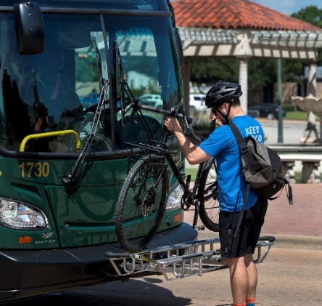
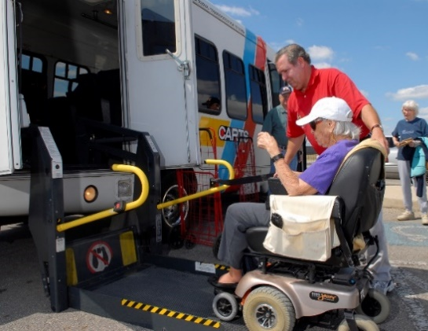
TxDOT Public Transportation Division – Eric Gleason, Director
Statewide and Rural Transit Planning
Bicycle and Pedestrian Planning
Active Transportation Planning
Transportation Alternative Funding
Transit Grant Management and Administration
Bicycle & Pedestrian Advisory Committee (BPAC)
Public Transit Advisory Committee (PTAC)

Slide 8
Texas Statewide Multimodal Transit Plan: What, Why, and Why Now

Slide 9
What is the Texas Statewide Multimodal Transit Plan?
A Plan for Texas
Current and future transit needs, challenges, and opportunities
Strategies to support public transit
Framework for prioritizing transit investments
Stakeholder-driven and collaborative approach
Comprehensive outreach and engagement strategy
Builds upon existing local, regional, and statewide plans
Steering Committee and Working Groups
First Texas Statewide Long-Range Transit Plan
Image by Freepik

Slide 10
Texas Statewide Multimodal Transit Plan: Why and Why Now?
Texas’ population and economy are growing
Response to high level of interest from public
Key component of Texas’ multimodal transportation network
Key to improve access, mobility, connectivity, safety, and congestion, as well as support economic development
Align with other long-range plans
Connecting Texas 2050
Statewide Active Transportation Plan
Texas Rail Plan
Capitalize on historic levels of investments in transportation
Support regional and local agency transportation plans and priorities

Slide 11
Texas’ Population is Projected to Grow (2020-2060)
Census Information
Projections - V2022 (2010-2020 - 1.0 Migration Rate)
29.1 M
36.8 M
44.4 M
2020
2040
2060
16% increase
26% increase
21% increase
25.1 M
29.1 M
36.8 M
2010
2020
2040
SOURCE: Texas Demographic Center, Vintage 2022 and 2018 Population Projections

Slide 12
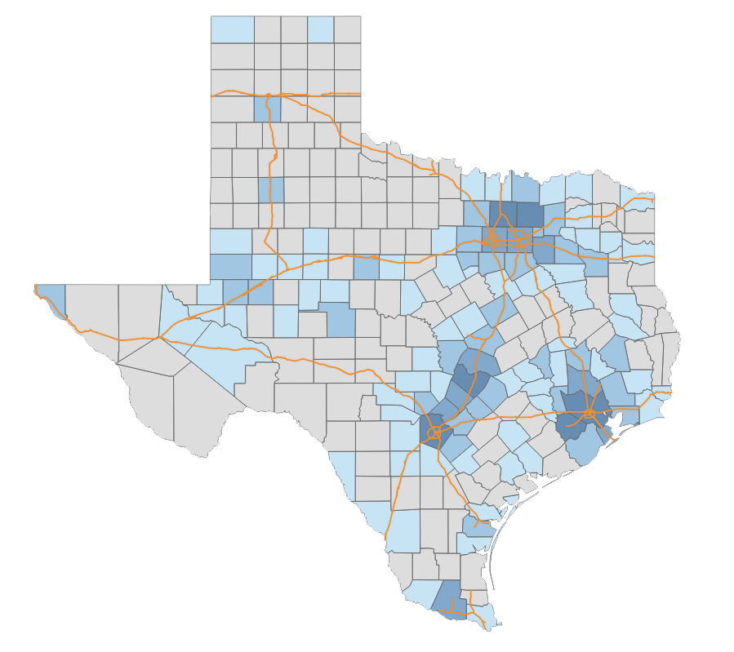
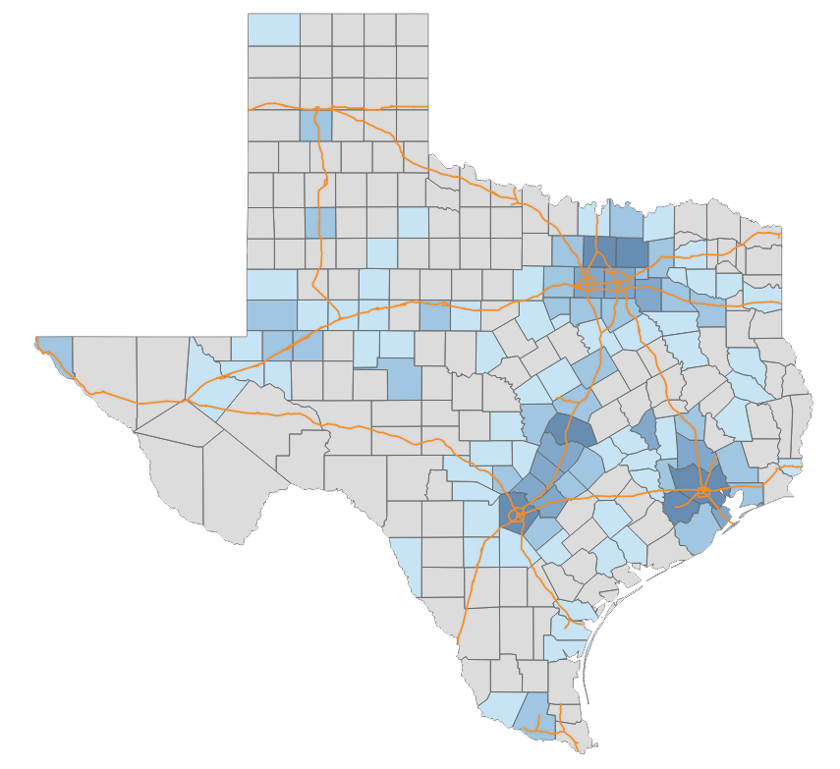
Texas Population Projection (2020 – 2060)
Population is Projected to Grow in and Around Urban Areas
Population Loss
Population Loss
1 to 9,999
2020 – 2040
1 to 19,999
2020 – 2060
10,000 to 99,999
20,000 to 199,999
100,000 to 499,999
200,000 to 999,999
500,000 or more
1,000,000 or more
Data source: Texas Demographic Center data projections. Vintage 2022 Population Projection - using the migration rates between 2010-2020

Slide 13
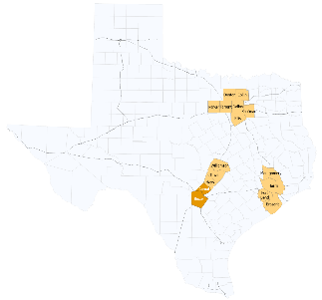
Texas Population Growth: Top Counties (2021 - 2022 )
County | US Rank | 2021 Population Estimate | 2022 Population Estimate | Population Change 2021-2022
Harris | 2 | 4,735,287 | 4,780,913 | 45,626 (1.0%⇧)
Collin | 3 | 1,114,450 | 1,158,696 | 44,246 (4.0%⇧)
Denton | 4 | 943,857 | 977,281 | 33,424 (3.5%⇧)
Fort Bend | 7 | 860,124 | 889,146 | 29,022 (3.4%⇧)
Bexar | 9 | 2,030,895 | 2,059,530 | 28,635 (1.4%⇧)
Montgomery | 10 | 650,261 | 678,490 | 28,229 (4.3%⇧)
Williamson | 12 | 644,451 | 671,418 | 26,967 (4.2%⇧)
Tarrant | 13 | 2,129,402 | 2,154,595 | 25,193 (1.2%⇧)
Travis | 20 | 1,308,544 | 1,326,436 | 17,892 (1.4%⇧)
Kaufman | 29 | 158,216 | 172,366 | 14,150 (8.9%⇧)
Hays | 36 | 256,065 | 269,225 | 13,160 (5.1%⇧)
Dallas | 38 | 2,587,954 | 2,600,840 | 12,886 (0.5%⇧)
Comal | 48 | 174,891 | 184,642 | 9,751 (5.6%⇧)
Brazoria | 50 | 378,858 | 388,181 | 9,323 (2.5%⇧)
Ellis | 52 | 203,107 | 212,182 | 9,075 (4.5%⇧)
Parker | 53 | 156,966 | 165,834 | 8,868 (5.6%⇧)
Highest population growth in Harris, Collin, Denton, Fort Bend, and Bexar.
Source: US Census Bureau, 2022 Population Estimates
Notes:
Slide needs to be updated

Slide 14
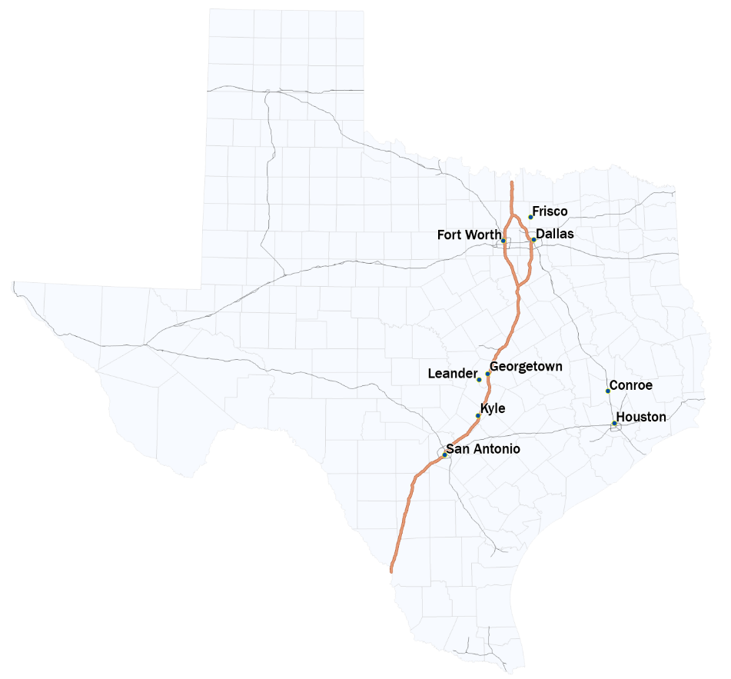
Texas Cities/Towns Population Growth (2021 to 2022)
National Ranking | City/Town
1 | Fort Worth
3 | San Antonio
4 | Houston
5 | Georgetown
11 | Dallas
13 | Frisco
20 | Leander
23 | Conroe
26 | New Braunfels
32 | Kyle

Slide 15
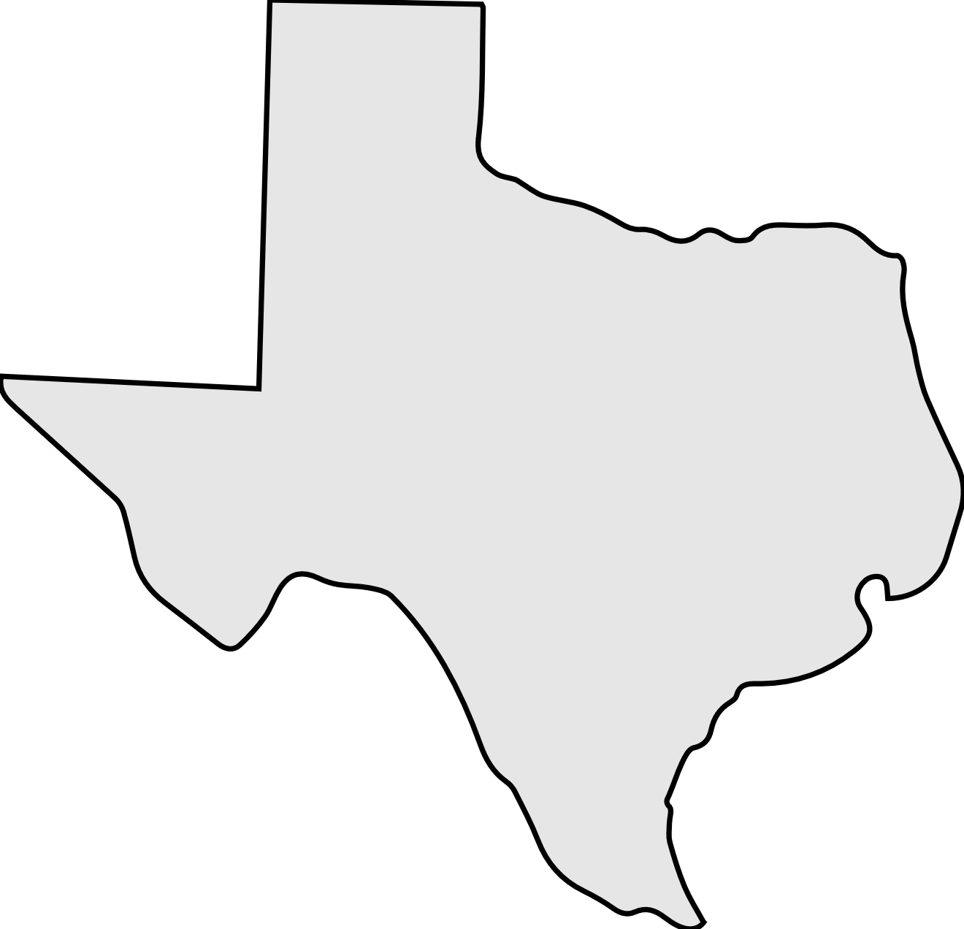
More People, More Cars, More Congestion ….
Within the four metropolitan areas- Fort Worth, Dallas, Houston, Austin, San Antonio
13B
Annual Cost
Of Congestion
523M
Annual Hours
of Delay
65%
State Population
The number of registered vehicles in Texas has risen by 172 percent in the past four decades In that same period, highway capacity has increased by only 19 percent
SOURCE: 2022 Urban Mobility Scorecard, Texas A&M Transportation Institute.

Slide 16
Texas Statewide Multimodal Transit Plan: Vision, Emphasis Areas, and Timeline

Slide 17
Texas Statewide Multimodal Transit Plan Vision
The Statewide Multimodal Transit Plan will identify actions necessary to increase mobility and connectivity options for all Texans, support economic development, and address congestion in regional and intercity corridors through 2050. It will be inclusive of all current and emerging forms of public transportation, supporting technologies, and intersection with other modes.
Vision Statement
Notes:
Against this Background, TxDOT is embarking on the development of the Statewide Multimodal Transit Plan.

Slide 18
Texas Statewide Multimodal Transit Plan: Emphasis Areas
Growth & Urbanization
Service Development
Transit Financing
Technology Advancement
Transit Markets
Making the Case for Transit

Slide 19
Texas Statewide Multimodal Transit Plan: Development Timeline
Ongoing collaboration with Steering Committee, working groups, transit agencies, other stakeholders, and the public
Stakeholder and Public Engagement
Existing Conditions and Trends Analysis
Opportunities and Gaps;
Service & Capital Needs
Funding, Financial, and Policy
Strategic Priorities & Investments; Implementation Framework
Project Kick-Off
Plan Adoption
2025
2023
2024
Fall Outreach Campaign
Working Groups
Spring Outreach Campaign
Formal Comment Period
Ongoing alignment with Connecting Texas 2050 and other related statewide plans

Slide 20
Texas Statewide Multimodal Transit Plan: Existing Conditions and Trends

Slide 21
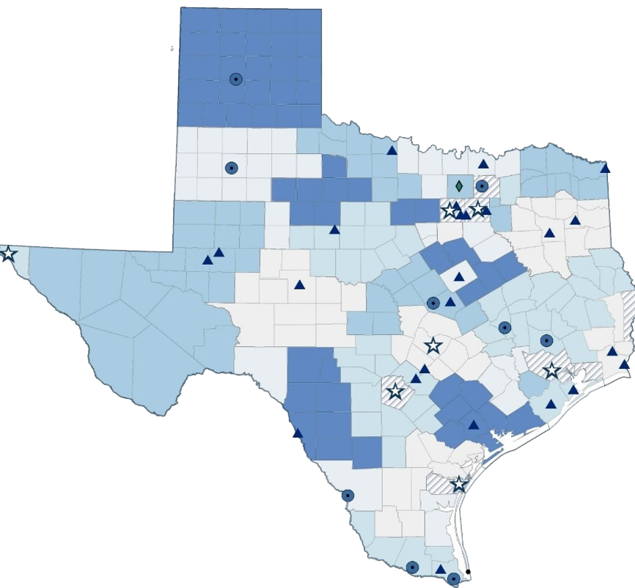
Current Transit System in Texas
MTAs, State Funded Urban and Rural Transit Districts (January 2024)
77 transit agencies
8 metropolitan transit authorities
9 large urban transit districts
24 small urban transit districts
36 rural transit districts
Over 99% of Texas’ counties have transit access
Cities served by metropolitan transit authorities
Transit system serves 275 million riders/year
Denton County Transportation Authority
Large urban transit districts (Population: 200,000 and over)
Small urban transit districts (Population: 50,000 to 199,999)
Invested $195 million in State and Federal funding (2023)
Rural Transit Districts
City of South Padre Island Rural Transit District
Not served by any rural transit district
* Pre-pandemic figure (2019)

Slide 22
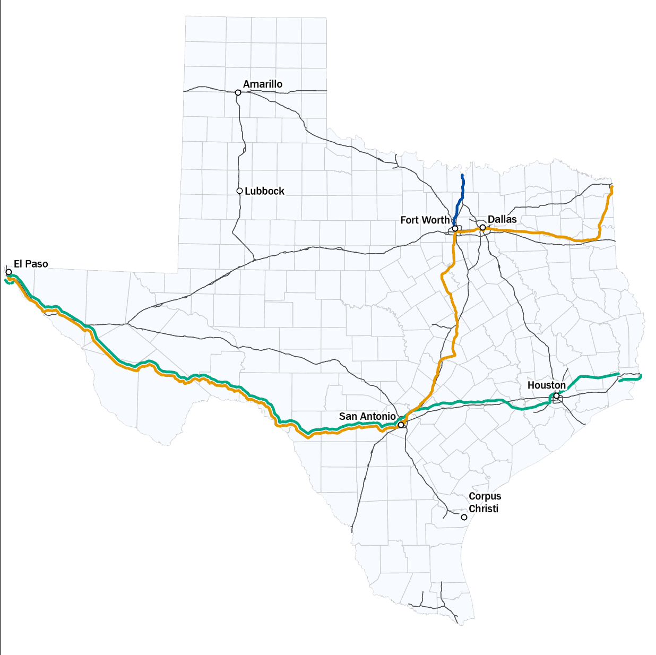
Current Inter-City Passenger Rail System in Texas
AMTRAK is the sole intercity passenger rail operator in Texas
AMTRAK runs three distinct service line in Texas
Major cities in Texas Triangle and El Paso are served
Intercity Rail Trips – Yearly Trend
Heartland Flyer
Sunset Limited
Texas Eagle

Slide 23
Transit Ridership in Texas (2019 – 2023)
Over 275 million rides/year
Recovery after Pandemic on par with national trends
Data source: Texas Transit Statistics Reports (*2023 figure is preliminary)

Slide 24
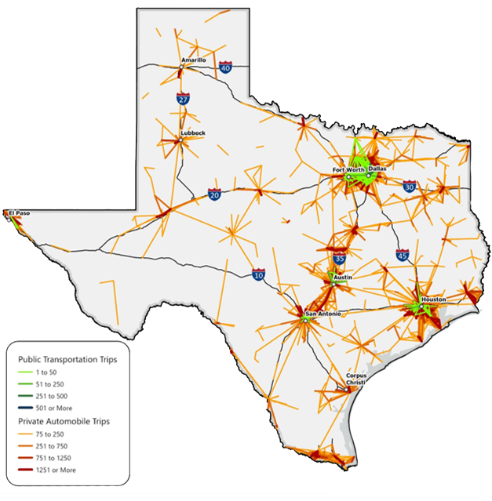
Key Transit Needs in Texas
Purpose of Transit Trips
Employment and job-seeking
Education and training
Medical and healthcare
Social and recreational activities
Tourism
Personal business/shopping/errands
Mobility and accessibility for:
Veterans
Adults 65 and older
Individuals with disabilities
Choice riders
Zero-vehicle household
Data source: Replica 2022

Slide 25
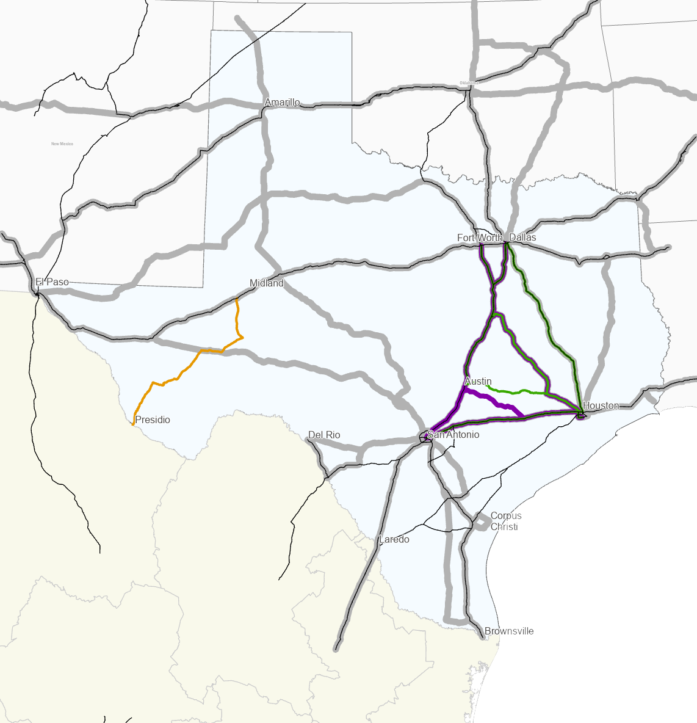
Texas Has Limited Intercity and Regional Transit Connectivity
Texas Triangle Megaregion
66 of Texas’ 254 counties
~ 75% of Texas’ population in 2022
~ 91% of Texas’ population growth (2010–2020)
Source: https://web.archive.org/web/20110930134227/http:/soa.utexas.edu/files/csd/ReinventingTexasTriangle.pdf U.S. Census
Intercity bus and rail coverage is limited
Service frequency, travel times, and costs are potential barriers
Limited service to pick-up and drop-off areas (“first mile/last mile”) presents challenge
Greyhound
Megabus
Vonlane
No direct Dallas Fort Worth-Houston Amtrak connection
All Aboard America!
Cross-Border Carriers
Notes:
Look at population in 2022

Slide 26
Texas Statewide Multimodal Transit Plan: Public/Stakeholder Outreach and Engagement

Slide 27
Stakeholder and Public Engagement Strategies
Public Awareness & Outreach
Steering Committee
Working Groups
Additional Stakeholder Engagement
Surveys and in-person “pop-up” outreach to understand public’s transit priorities
Policy-focused meetings with experts to define goals and objectives, approve vision, provide direction, and review findings
Technical-focused meetings with subject-matter experts who can provide input on emphasis areas
Meetings and conversations with stakeholders to gather insights

Slide 28
Public Engagement: Statewide Survey Key Findings
Purpose of Transit Trips
2,198
Work or job-seeking
Education and training
Medical and healthcare
Personal business, shopping or errands
Social and recreational activities
COMPLETED SURVEYS
465
IN-PERSON
Key Transit Needs/Challenges
Expand transit service to more areas
Improve frequency of current transit service
Increase hours of service/weekend service
Reduce cost and improve reliability of current transit service
Improve intercity and regional connectivity
1,733
ONLINE

Slide 29
Key Stakeholder Groups: Initial Input
Semi-Annual Operators Meeting
Metropolitan Transit Authorities Meeting
July 13, 2023
AUGUST 31, 2023
Top Priorities
Improve service frequency
New/renovated facilities
Increase service hours (existing service)
Challenges
Workforce
Local match funding
Facilities and fleet
2050 Visioning
Establish fixed network of intercity service connections
Expand mobility options
Leverage technology
Top Priorities
Improve service frequency
Increase accessible hours/increase hours (existing services)
Additional service coverage
Challenges
Workforce
Policy/public perception
Funding
2050 Visioning
Expand mobility options in congested corridors
Address intercity and regional connectivity
Revise institutional and legal frameworks supporting governance, operation, and financing
Increase access to services and ensure safe, reliable, and efficient operation
Improve economic opportunities and quality of life

Slide 30
Texas Statewide Multimodal Transit Plan: Next Steps

Slide 31
Texas Statewide Multimodal Transit Plan: Development Timeline
Ongoing collaboration with Steering Committee, working groups, transit agencies, other stakeholders, and the public
Stakeholder and Public Engagement
Existing Conditions and Trends Analysis
Opportunities and Gaps;
Service & Capital Needs
Funding, Financial, and Policy
Strategic Priorities & Investments; Implementation Framework
Project Kick-Off
Plan Adoption
2025
2023
2024
Fall Outreach Campaign
Working Groups
Spring Outreach Campaign
Formal Comment Period
Ongoing alignment with Connecting Texas 2050 and other related statewide plans

Slide 32
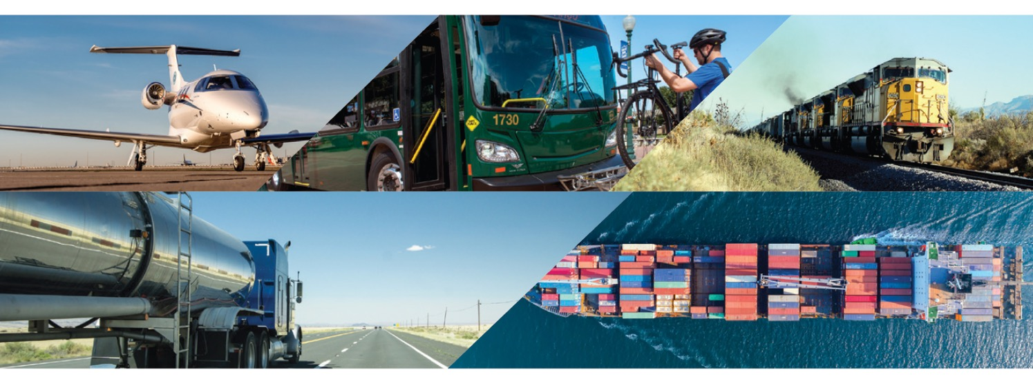
Questions?

