Slide 1
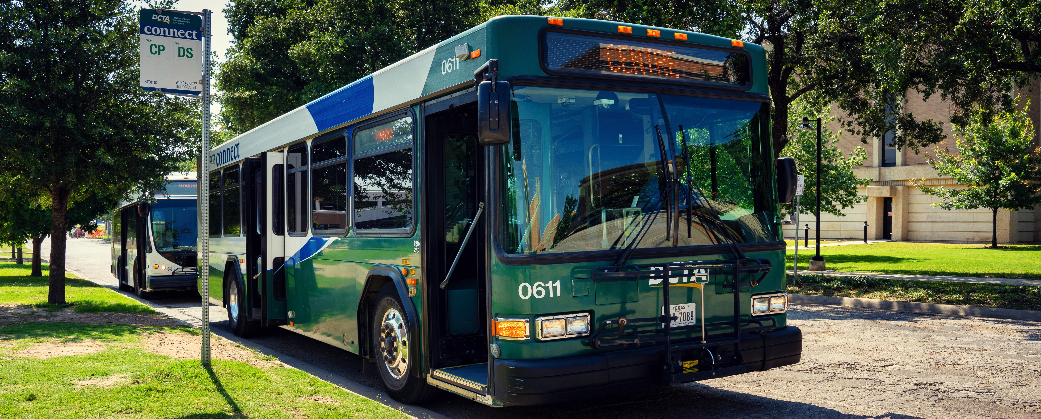
Texas Multimodal Statewide Transit Plan
Caroline A Mays, AICP
Director of Planning and Modal Programs
Photo Source: Denton County Transportation Authority
Transit Coalition of North Texas
Annual Luncheon, 2024

Slide 2
Today’s
Agenda:
1 | Overview of Texas Statewide Transit Plan
2 | Overview of Transit in Texas Today
3 | Key Transit Needs and Challenges in Texas
4 | Preliminary Strategies & Recommendations
5 | Next Steps

Slide 3


Growing with Texas
As economic and population growth continue to thrive, people and businesses will need multiple transportation options.
Texas SMTP 2050 :
Why and Why Now?
Transit helps Texans thrive.
Giving Texans options
TxDOT has heard Texans want options when it comes to getting around our state.
In response to a high level of interest from the public, SMTP 2050 seeks to make sure transit continues to help Texans thrive – now, and in the future.
Connecting Texans
In our outreach work, we’ve heard that Texans want to be more connected to other towns and cities in the state.
Alignment and Collaboration
By aligning with Connecting Texas 2050, the Statewide Active Transportation Plan, and the Rail Plan, SMTP 2050 will work to ensure that transit is integrated with the Texas multimodal network and provides choices for both individuals and businesses.
Notes:
Transit fuels our economy.
DART light rail development made an estimated $10 billion economic impact from 2016-2018.
Grapevine, TX increased sales tax revenue by almost 40% for businesses within a 5-minute walk of TEXRail’s DFW airport-to-Fort Worth rail line.

Slide 4
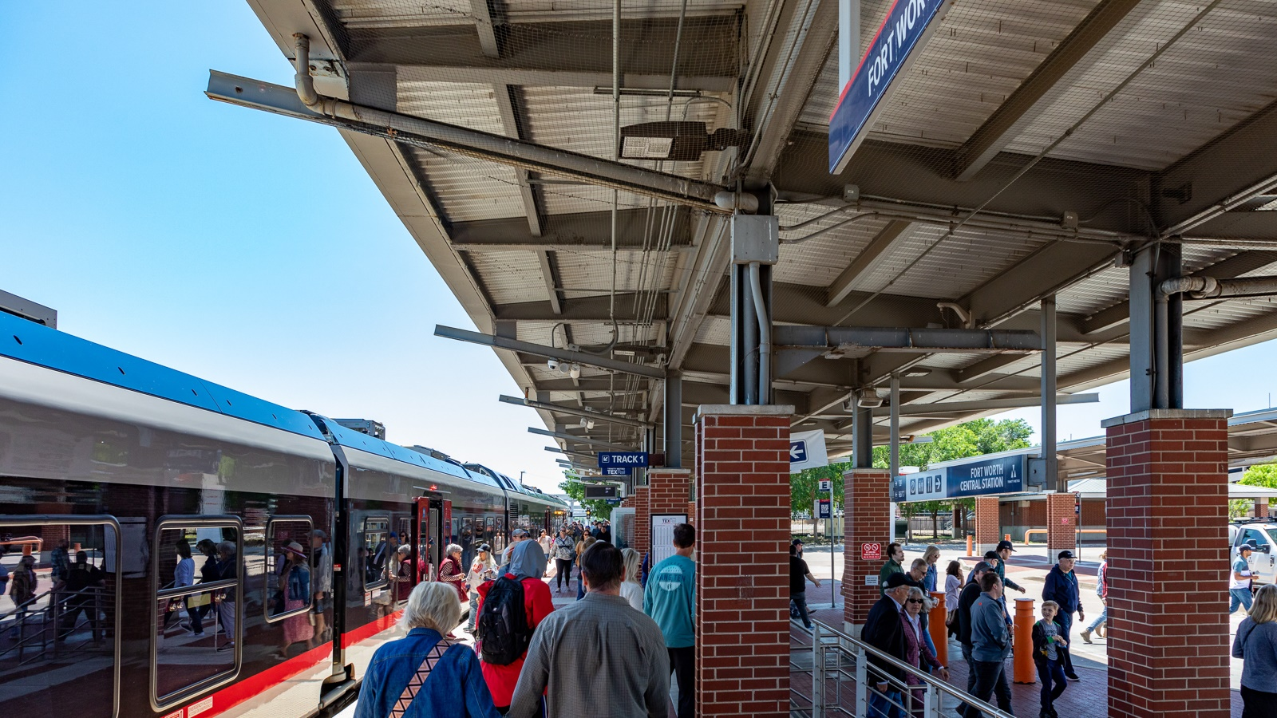




Texas Transit Vision
A safe, universally accessible, and integrated network of transit mobility options that connects people seamlessly, both locally and across the state, supporting an improved quality of life and a resilient and vibrant economy by 2050 and beyond.
Photo Source: Trinity Metro

Slide 5


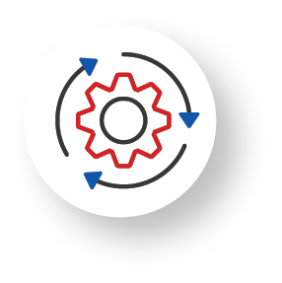
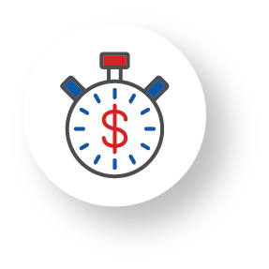
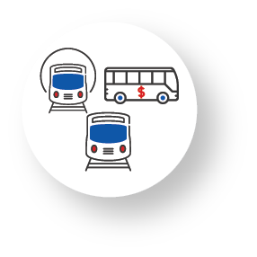

Texas Statewide Transit Plan Goals
Safety and Security
Maintain a transit network that is safe and secure, strives towards zero fatalities, and fosters a culture of transportation safety and security in Texas.
Connectivity
Provide local and interregional connectivity for everyone that is coordinated, affordable, accessible, reliable, and easy to use.
Asset Preservation
Maintain and preserve a resilient and high-quality transit system that is financially stable and operates in a state of good repair to meet community need.
Economic Vitality
Ensure the long-term economic competitiveness of Texas through community and workforce development by supporting a holistic and accessible transit system.
Mobility
Support an integrated transportation system that efficiently and effectively enhances access to work, school, essential services, and recreation activities.
Stewardship
Embrace a fiscally responsible multimodal approach to preserve natural, cultural, and human resources by reducing impacts for a sustainable and resilient transit network.

Slide 6

Texas SMTP 2050 Development Timeline
Stakeholder and Public Engagement
Ongoing collaboration with Steering Committee, working groups, transit agencies, other stakeholders, and the public
Emphasis Area Working Groups
Project
Kickoff
2023
2024
Fall Outreach Campaign
Spring Outreach Campaign
Fall Outreach Campaign
Presentation to TTC
Ongoing alignment with Connecting Texas 2050, SATP, and other related statewide plans

Slide 7


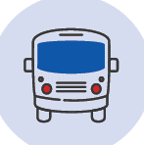

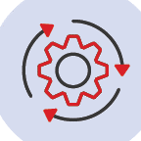
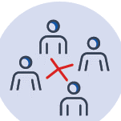
Public and Stakeholder Engagement To-Date
75
working group members provided insights during 3 rounds of Emphasis Area Working Group meetings
20
Steering Committee Members offered guidance on plan development during 3 meetings
100⁺
industry professionals gave feedback over the course of 3 Texas Semi-Annual Operators meetings in 2023 and 2024
23
MPO leaders were engaged at a 2024 Texas Association of Metropolitan Planning Organizations meeting
60⁺
representatives from 20 MPOs and economic development groups attended 15 stakeholder meeting discussions and offered insights on local and regional needs
10K
stakeholders
received an email
announcement from TxDOT with info about the SMTP and links to the public survey

Slide 8
Overview of Current Texas Transit System

Slide 9
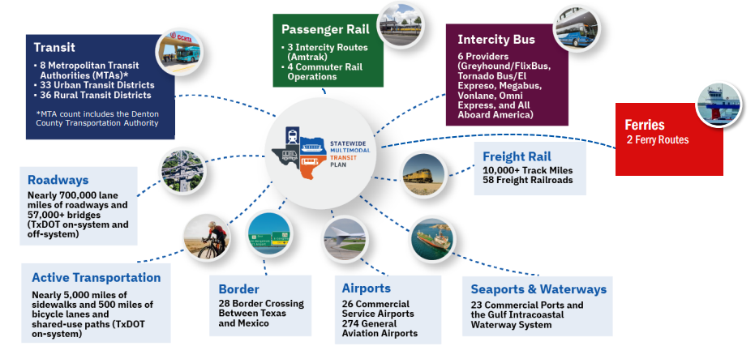
Texas Population Projection (2020 – 2060)
Overview of Texas’ Multimodal Transportation Network

Slide 10
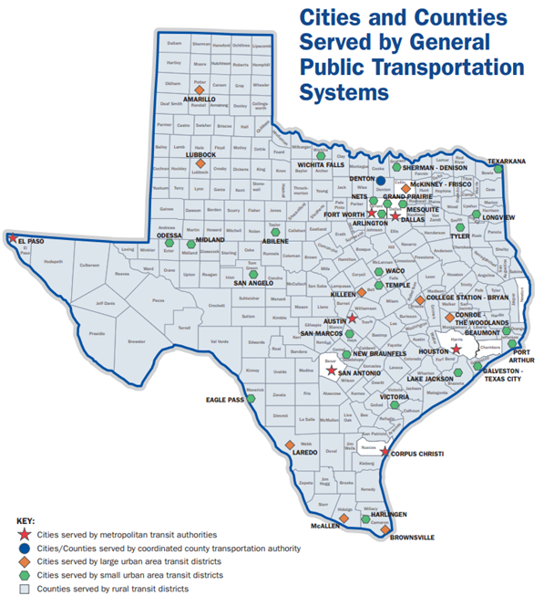
Texas Population Projection (2020 – 2060)
Overview of Texas Public Transportation System
There are 77 public transit providers operating in Texas:
8 Metropolitan Transit Authorities
9 Large Urban Transit Districts
24 Small Urban Transit Districts
36 Rural Transit Districts
Modes of transit service include bus service such as fixed route, bus rapid transit, and commuter services.
Several larger systems offer commuter rail, light rail and streetcar service. Other services include demand response, taxi, and vanpool services.
In 2023, public transit providers in Texas provided 205 million passenger trips and 1.3% of commutes were made by transit.

Slide 11
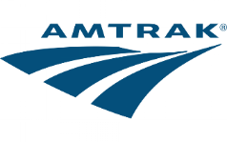
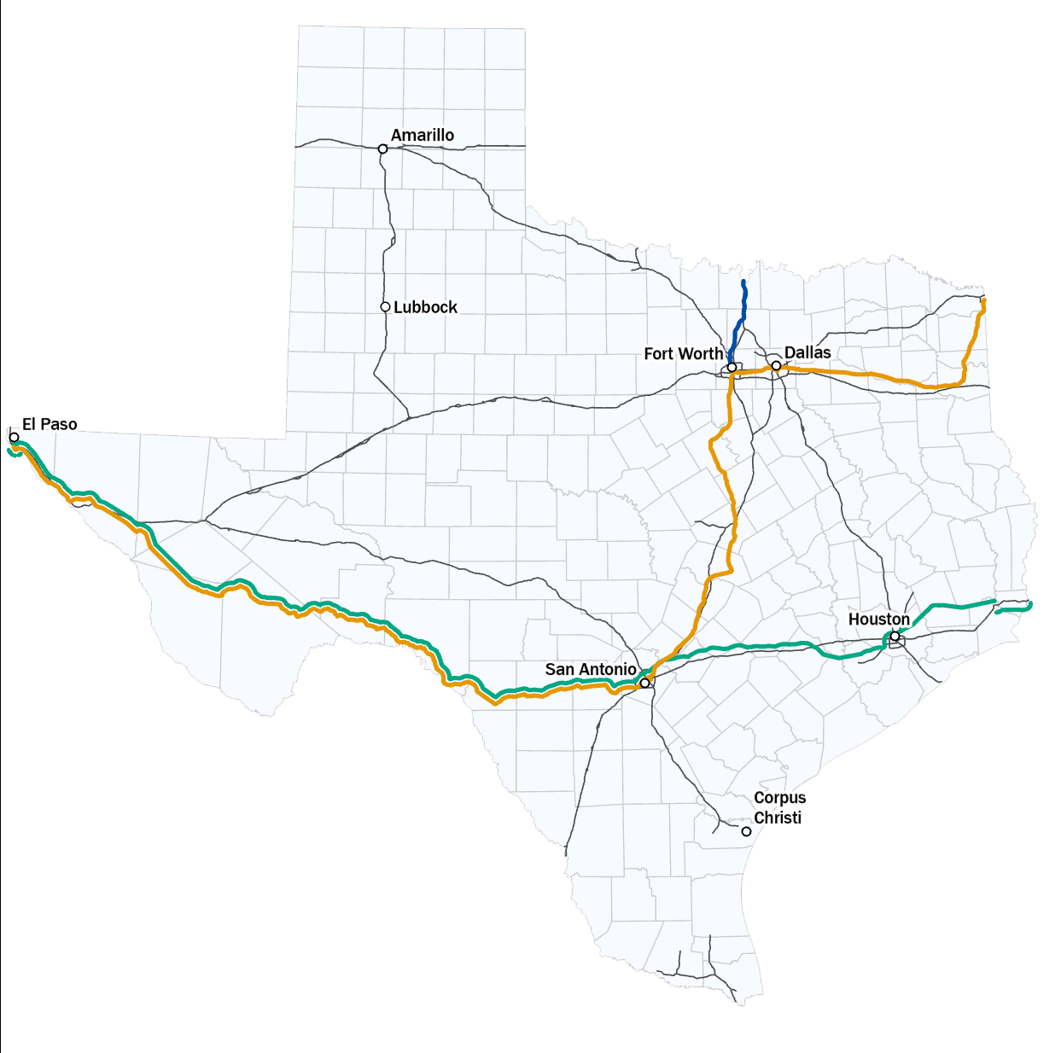
Current Inter-City Passenger Rail System in Texas
AMTRAK is the sole intercity passenger rail operator in Texas
AMTRAK runs three distinct service line in Texas
Major cities in Texas Triangle and El Paso are served
Intercity Rail Trips – Yearly Trend
Heartland Flyer
Sunset Limited
Texas Eagle

Slide 12

Transit Ridership in Texas (2019 – 2023)
Recovery after Pandemic on par with national trends
Data source: Texas Transit Statistics Reports (*2023 figure is preliminary)
Data source: Texas Transit Statistics Reports (*2023 figure is preliminary)

Slide 13
Key Transit Needs, Gaps, and Challenges in Texas

Slide 14




Key Transit Needs, Gaps, and Challenges in Texas
1
Growing population, urbanization, and congestion
Limited intercity connectivity – improve urban and rural transit connectivity
6
Lack of governance and institutional structure to deliver transit in the Texas Triangle
7
Lack of statewide transit service network and connectivity
2
8
Funding gap – need for additional funding for existing and new transit networks
3
Limited passenger rail network in Texas
9
State of good repair – need to maintain existing transit assets
4
Need to expand rural transit service area and hours of operation
Funding gap – limited transit funding options for existing and new transit networks
10
5
Need to expand urban transit service area and hours of operation

Slide 15
Key Transit Needs, Gaps, and Challenges in Texas
11
Rapid economic growth - Lack of transit service to jobs
Lack of coordination between land use planning and transit service
15
12
Lack of understanding of the importance of transit to the Texas economic prosperity
Lack of coordination between businesses and transit agencies
16
13
Lack of understanding of the role of transit in the Texas multimodal transportation System
Lack of consideration for transit in the transportation planning and design process
17
14
Need for better integration of emerging technologies
18
Aging transit infrastructure and assets

Slide 16

Texas’ Projected Population Growth (2020-2060)
Census Information
Projections - V2022 (2010-2020 - 1.0 Migration Rate)
29.1 M
36.8 M
44.4 M
2020
2040
2060
16% increase
26% increase
21% increase
25.1 M
29.1 M
36.8 M
2010
2020
2040
SOURCE: Texas Demographic Center, Vintage 2022 and 2018 Population Projections

Slide 17

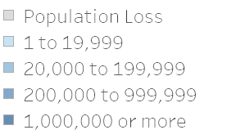
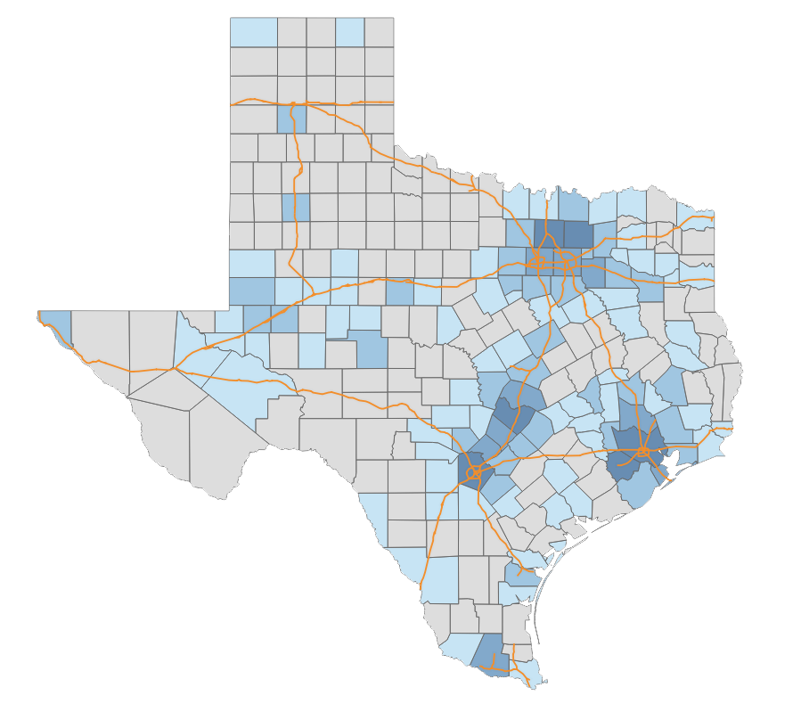
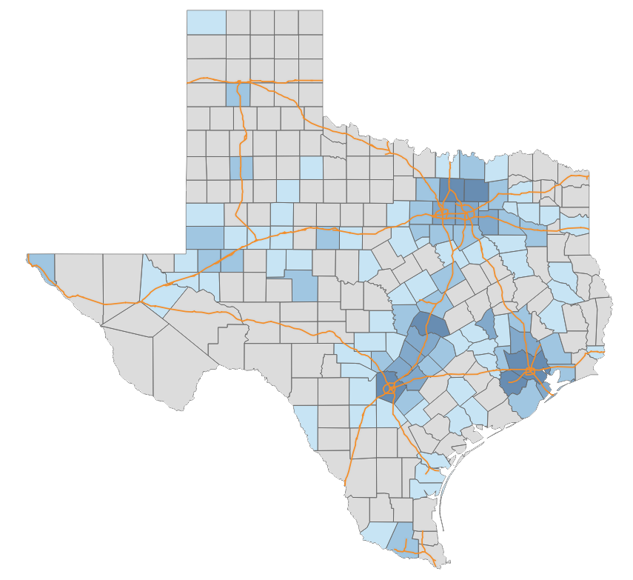
Texas Population Projection (2020 – 2060)
Urbanization and Texas Population Projection (2020 – 2060)
Population is Projected to Grow in and Around Urban Areas
Population Loss
Population Loss
1 to 9,999
2020 – 2040
1 to 19,999
2020 – 2060
10,000 to 99,999
20,000 to 199,999
100,000 to 499,999
200,000 to 999,999
500,000 or more
1,000,000 or more
70%
State Population
Data source: Texas Demographic Center data projections. Vintage 2022 Population Projection - using the migration rates between 2010-2020

Slide 18



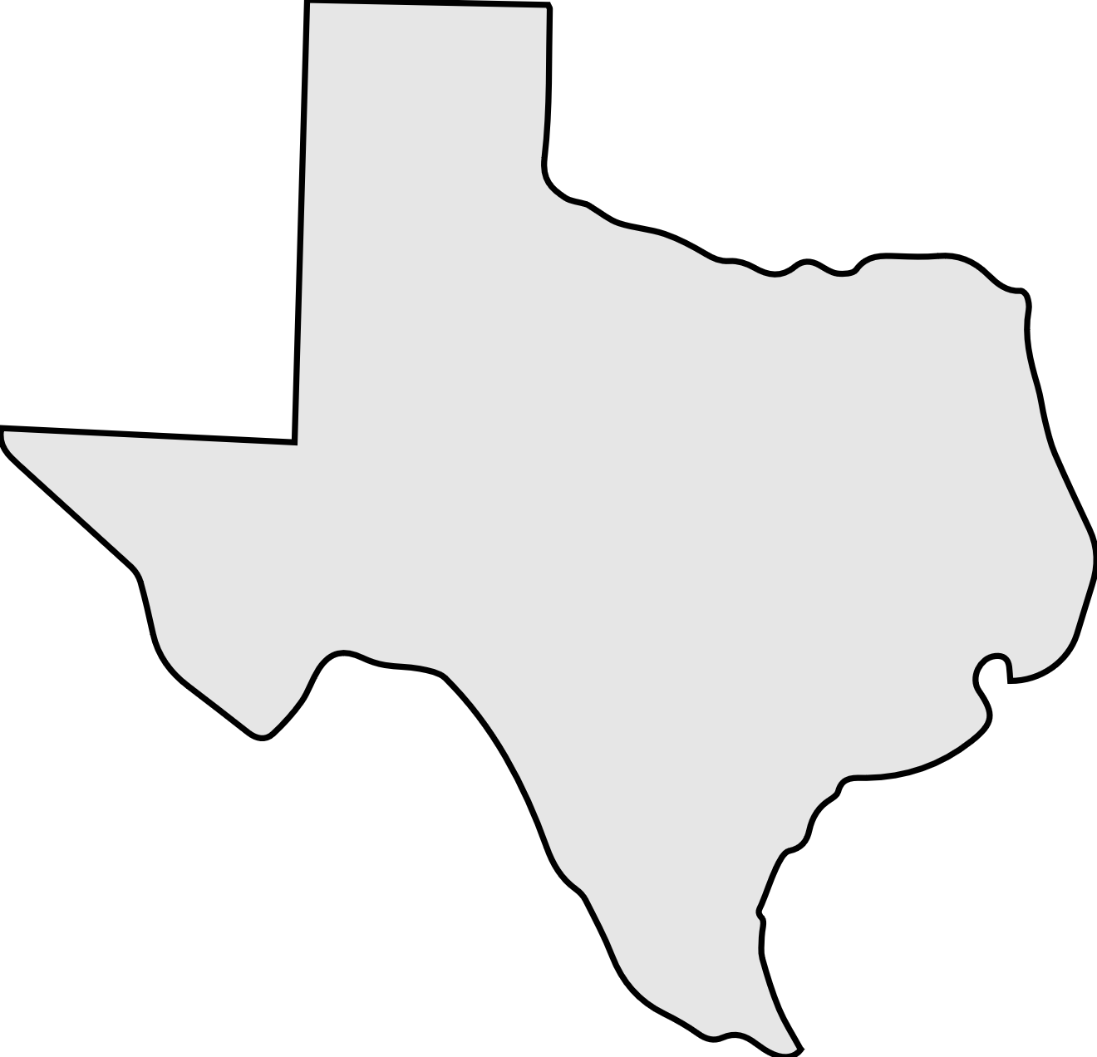
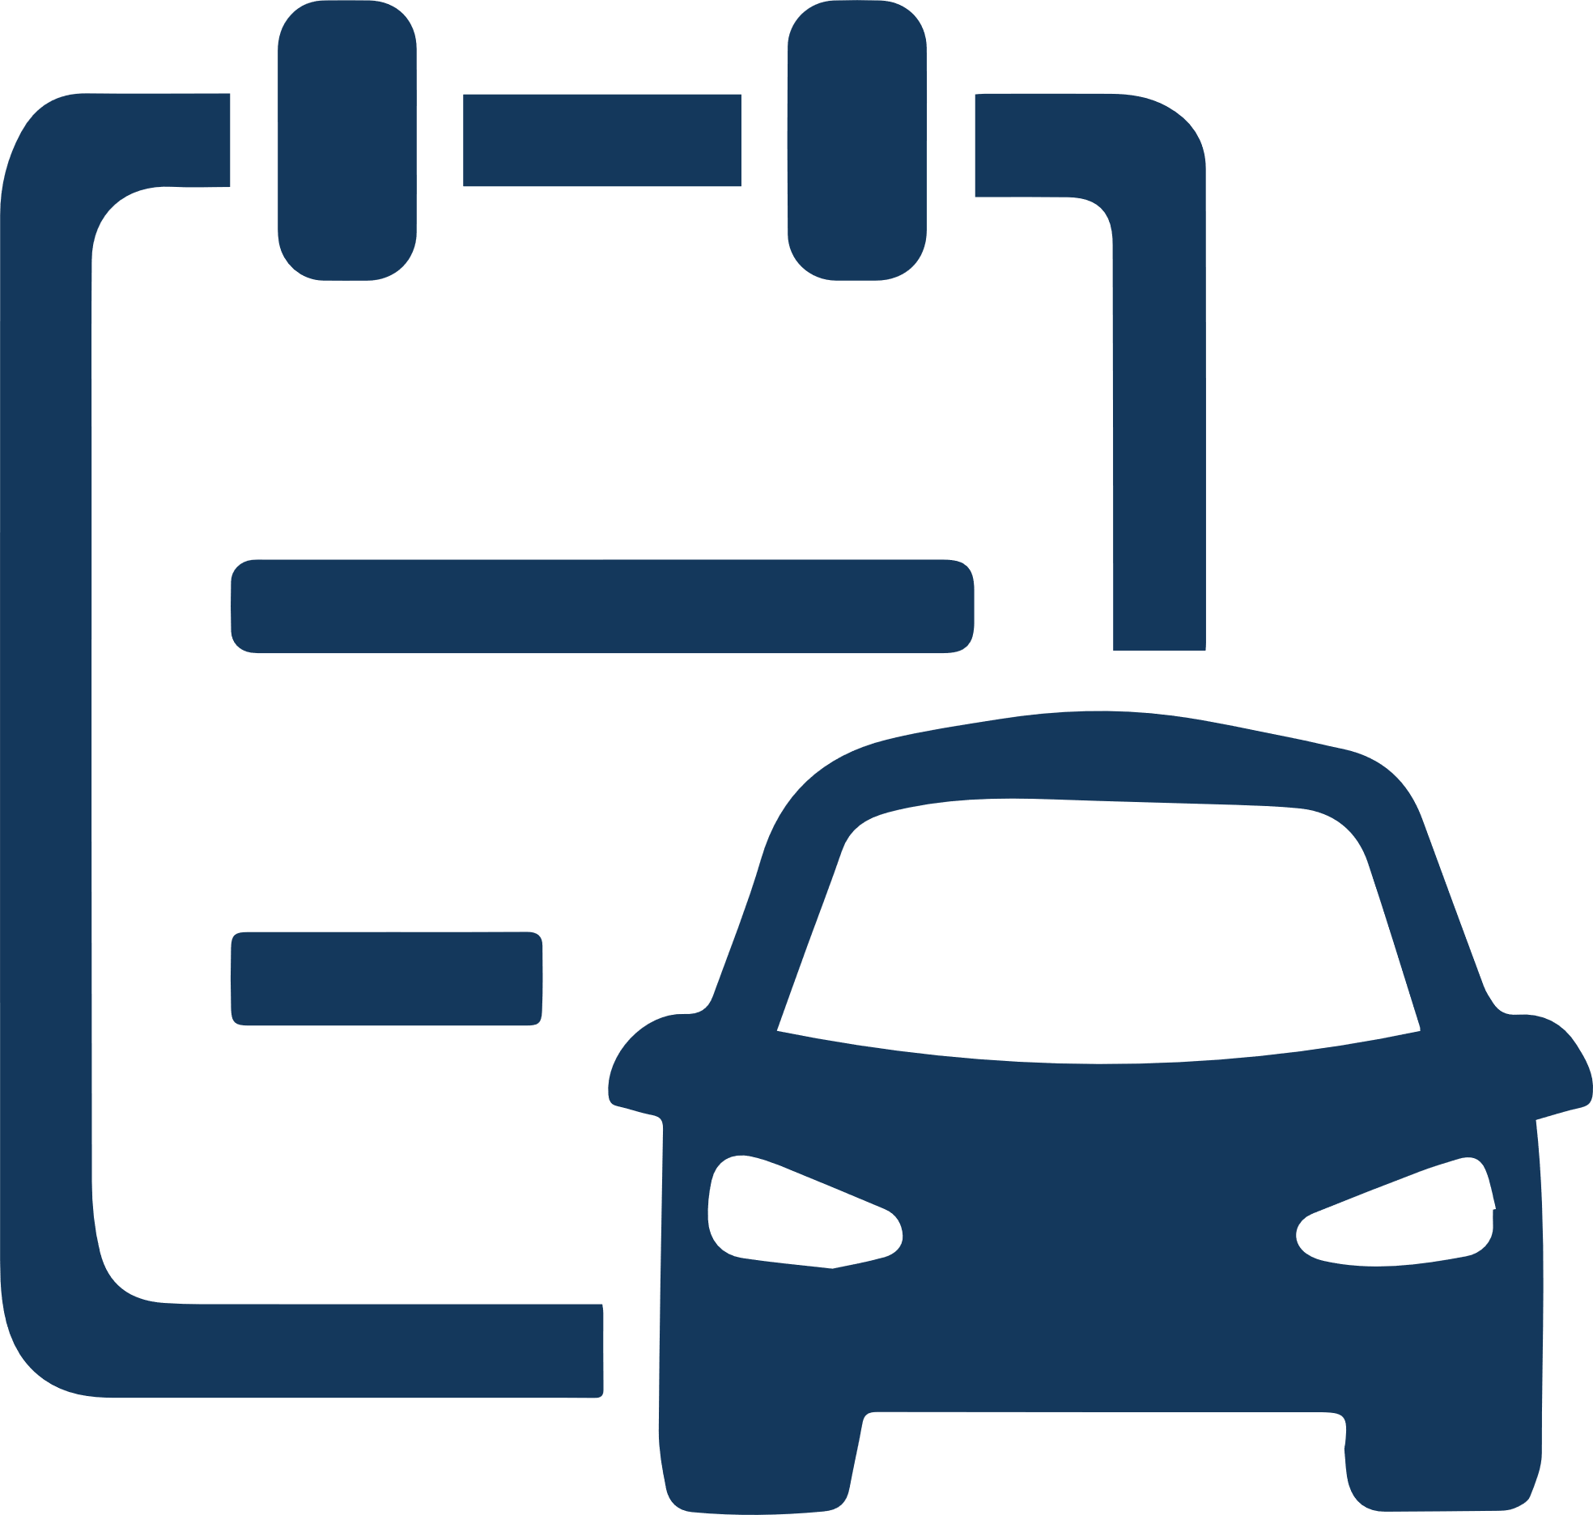
More People, More Cars, More Congestion
Within the four metropolitan areas- Fort Worth, Dallas, Houston, Austin, San Antonio
13B
Annual Cost
of Congestion
523M
Annual Hours
of Delay
70%
State Population
The number of registered vehicles in Texas has risen by 172 percent in the past four decades.
In that same period, highway capacity has increased by only 19 percent.
SOURCE: 2022 Urban Mobility Scorecard, Texas A&M Transportation Institute.

Slide 19
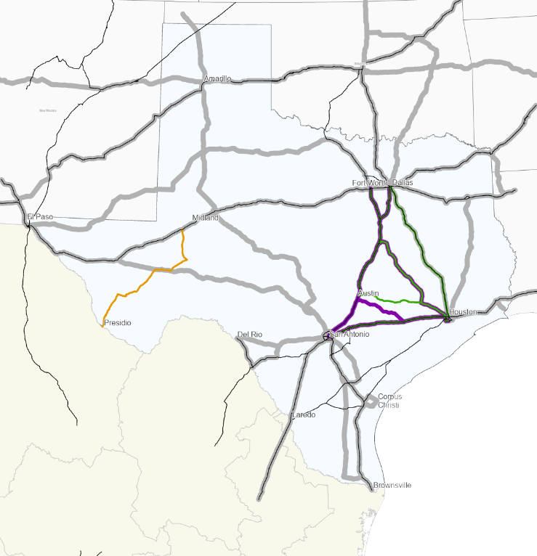
Limited Intercity and Regional Transit Connectivity
Texas Triangle Megaregion
  66 of Texas’ 254 counties
  ~ 75% of Texas’ population in 2022
  ~ 91% of Texas’ population growth (2010–2020)
Limited Intercity Bus and Rail Coverage
  Service frequency, travel times, and costs are
  potential barriers
Greyhound
Megabus
  Limited service to pick-up and drop-off areas (“first mile/last mile”) presents challenge
Vonlane
All Aboard America!
  No direct Dallas Fort Worth-Houston Amtrak connection
Cross-Border Carriers
Source: https://web.archive.org/web/20110930134227/http:/soa.utexas.edu/files/csd/ReinventingTexasTriangle.pdf
U.S. Census
Notes:
Look at population in 2022

Slide 20



Texas Annual Transit Funding Sources (2022): $3.67B
*
All Transit Agencies
Local funding constitutes nearly 3/4 of all transit funding in Texas, with the federal government providing most of the rest. Fares and state funding combined total less than 5%.
*Temporary Federal COVID pandemic relief funding.
Source: 2022 PTN Applied Revenues Report, TTI.
Notes:
Annual funding sources for all sources in 2022 amounted to $3.67 billion
Local funding constitutes nearly 3/4 of all transit funding in Texas, with the federal government providing most of the rest. Fares and state funding combined total less than 5%.
The majority of these local funds are attributed to the large urban and metro transit authorities
Note that COVID Relief funds were provided for temporary emergency relief and will not be sustained once expended.

Slide 21
Gap Between Available Funds and Needs – All Rural Transit Districts
Peak annual gap: $145 million in 2048
Future cumulative gap (2024-2050) of $2.1 billion nominal dollars
Future cumulative gap net present value of $1.1 billion
Notes:
Looking at the transit agencies that TxDOT is the Designated Recipient for…
Rural transit districts are most dependent on federal funding, which makes up almost 70% of their revenue, including pandemic emergency funding.
Annual funding sources for rural transit districts in 2022 amounted to $135.5 Million

Slide 22
Gap Between Available Funds and Needs – All Urban Transit Agencies
Future cumulative gap (2024-2050) of $6.2 billion nominal dollars
Future cumulative gap net present value of $3.2 billion
Peak annual gap: $458 million in 2050
Notes:
Urban districts have more funding sources than rural districts.
Federal funding sources, including pandemic emergency funding, currently makes up about 62% of revenue for urban transit districts.
Local sources comprise approximately 1/3 of revenue sources.

Slide 23
Sample Preliminary Strategies and Recommendations

Slide 24
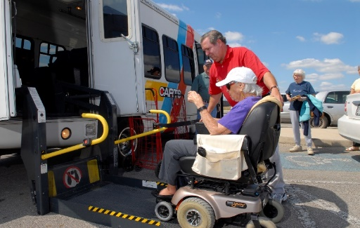
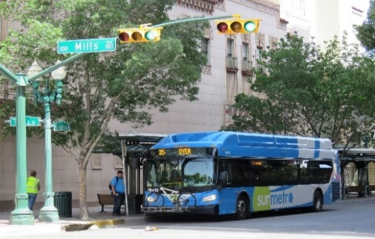
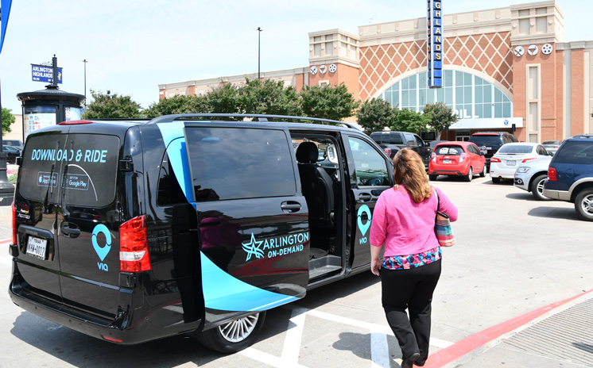
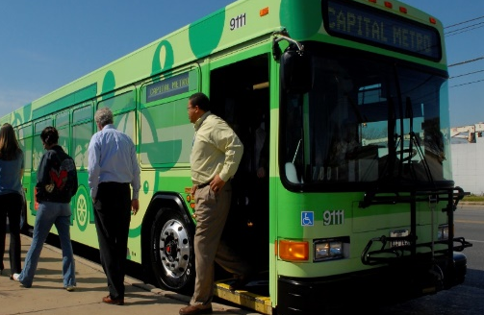
Preliminary Strategies and Recommendations
Expand existing rural transit service and connectivity
Expand existing urban transit service and connectivity
Improve urban and rural transit connectivity
Develop new urban and rural transit corridors
Explore new institutional and legal frameworks supporting transit governance, operation, and financing
Improve connectivity between urban and rural transit to enhance access and mobility options
Expand existing urban transit system to improve service coverage and access and mobility options
Develop new urban and rural transit system to improve service coverage and access and mobility options
Notes:
A key area of feedback from transit operators centered around funding and resources. Common themes included:
Complexity of grant programs
Lack of staff with funding expertise and knowledge
Lack of local match
Difficulties purchasing vehicles
Dwindling number of US vehicle manufacturers
Difficult to comply with Buy America requirements
Increasing vehicle costs
Lack of group purchasing contracts
Some agencies relying on Oklahoma group purchasing agreement
2050 Visioning
Expand mobility options in congested corridors
Address intercity and regional connectivity
Revise institutional and legal frameworks supporting governance, operation, and financing
Increase access to services and ensure safe, reliable, and efficient operation
Improve economic opportunities and quality of life
Establish fixed network of intercity service connections
Expand mobility options
Leverage technology

Slide 25
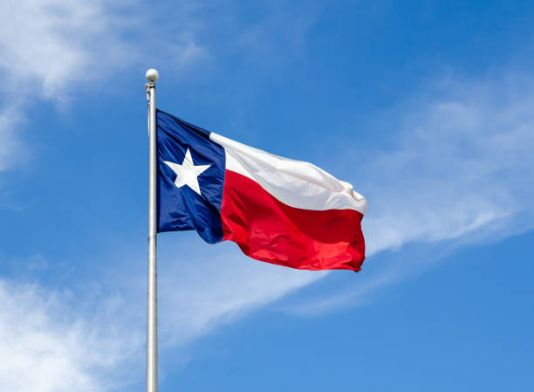
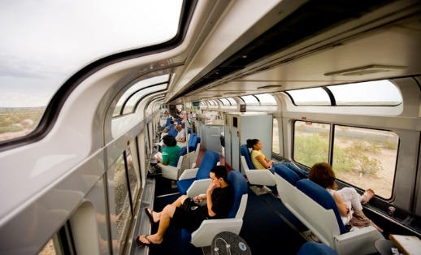

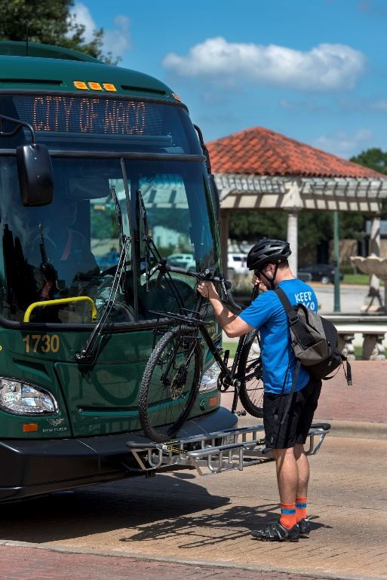
Preliminary Strategies and Recommendations
Governance and Institutional Framework
a
Expand passenger rail network
Integrate all transit modes
Intercity and Regional Transit Connectivity
Explore new institutional and legal frameworks supporting regional and transit governance, operation, and financing
Develop and expand passenger rail network in the Texas Triangle and statewide
Address regional and intercity transit connectivity
Explore opportunities for modal transit integration
Notes:
A key area of feedback from transit operators centered around funding and resources. Common themes included:
Complexity of grant programs
Lack of staff with funding expertise and knowledge
Lack of local match
Difficulties purchasing vehicles
Dwindling number of US vehicle manufacturers
Difficult to comply with Buy America requirements
Increasing vehicle costs
Lack of group purchasing contracts
Some agencies relying on Oklahoma group purchasing agreement
2050 Visioning
Expand mobility options in congested corridors
Address intercity and regional connectivity
Revise institutional and legal frameworks supporting governance, operation, and financing
Increase access to services and ensure safe, reliable, and efficient operation
Improve economic opportunities and quality of life
Establish fixed network of intercity service connections
Expand mobility options
Leverage technology

Slide 26
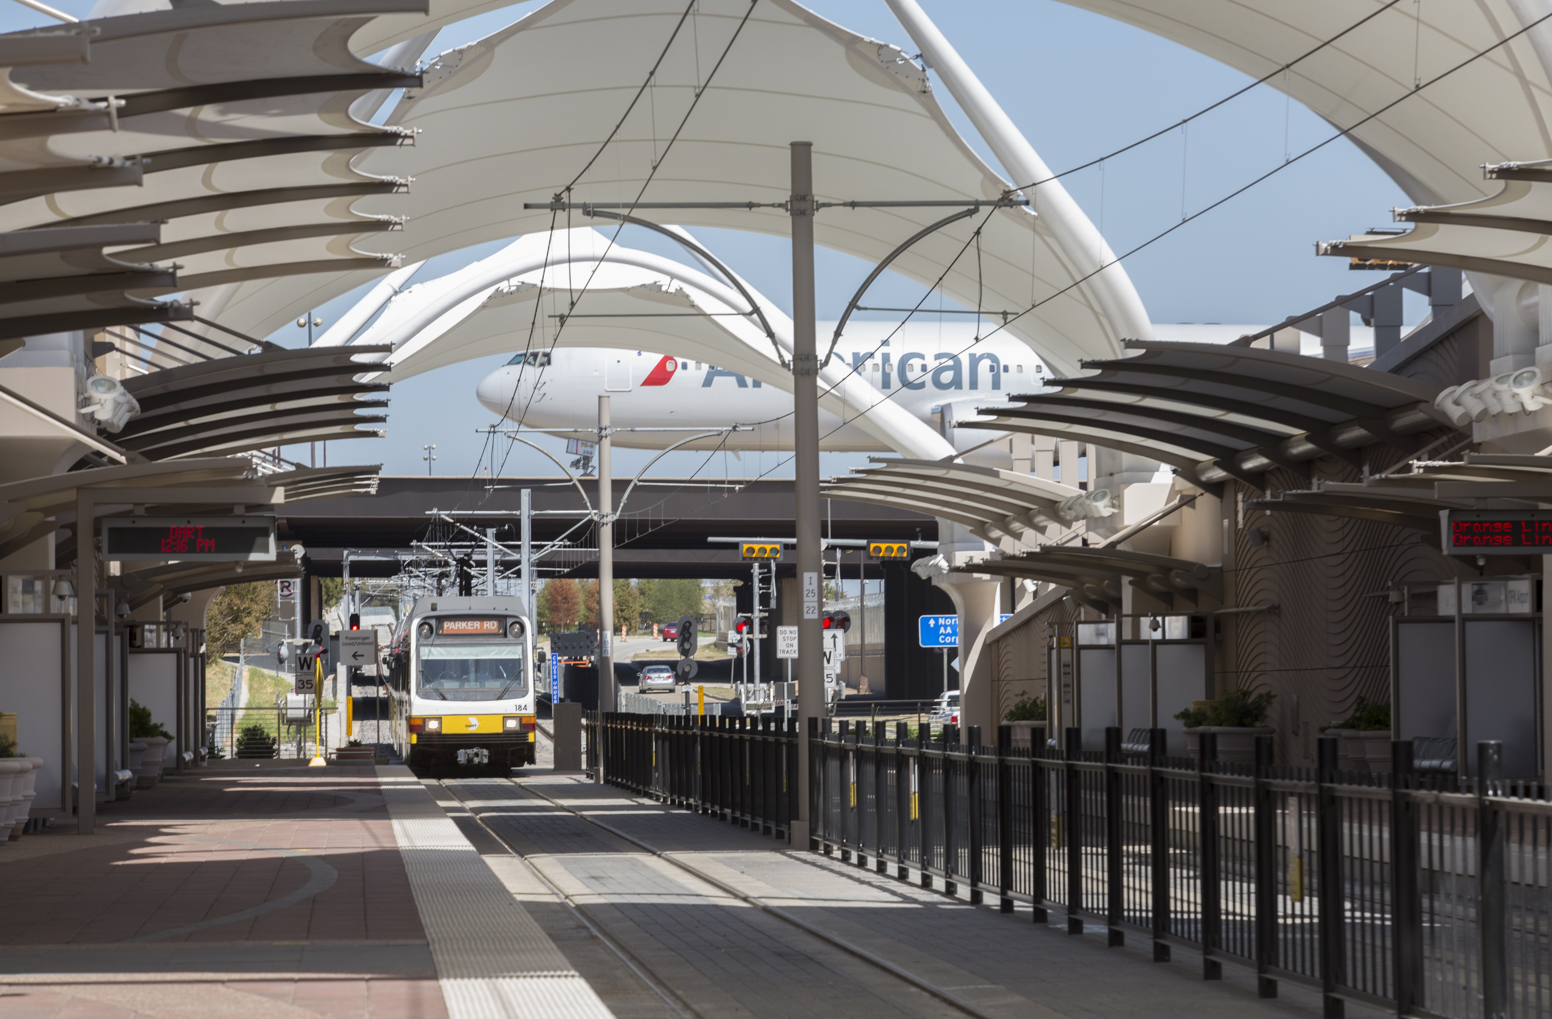
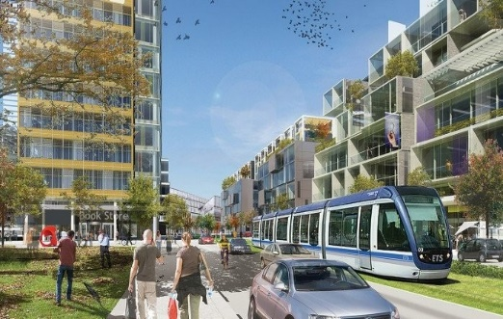
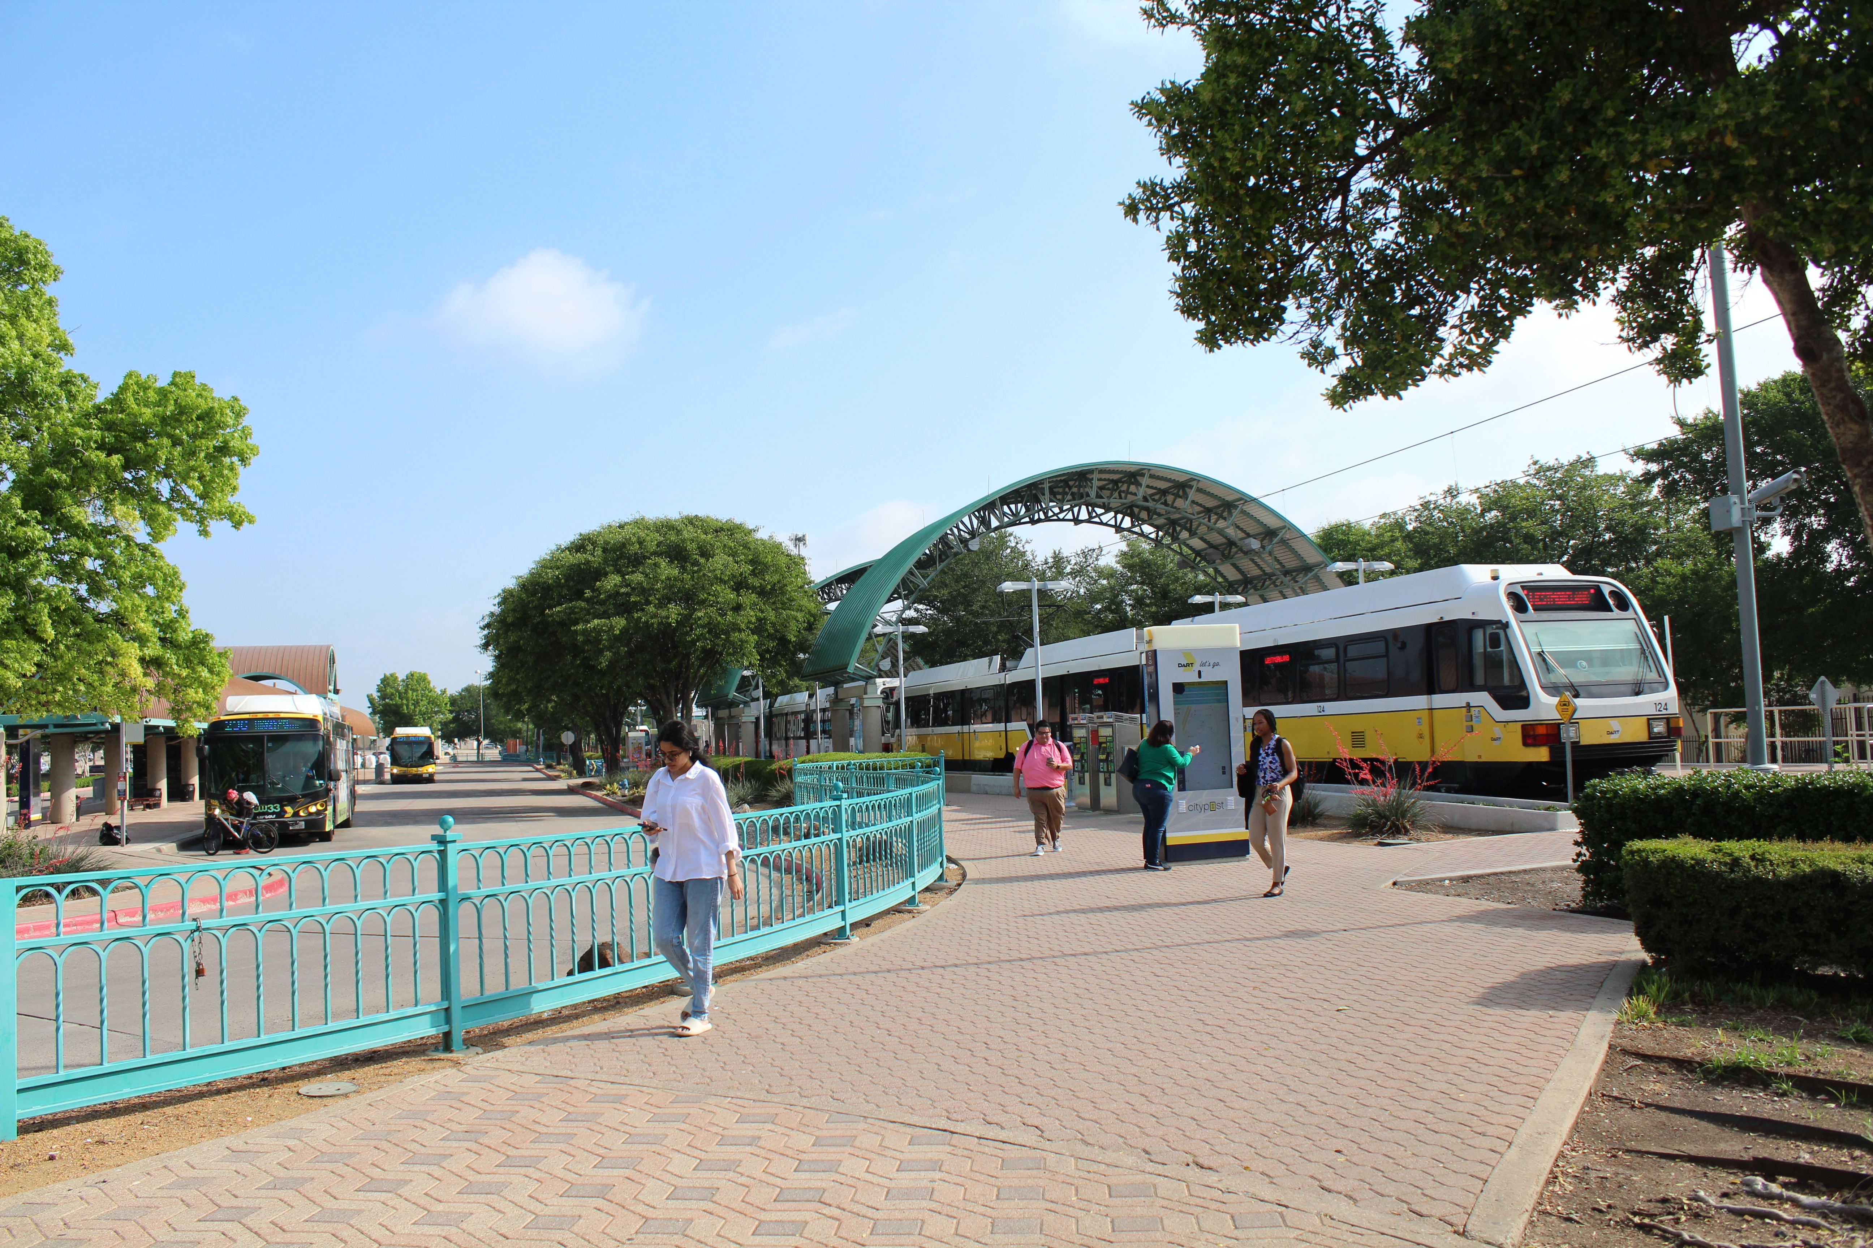
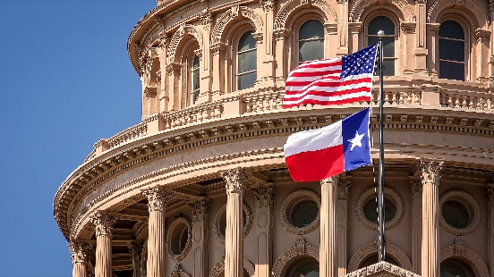
Preliminary Strategies and Recommendations
Expand multimodal connectivity between transit and other modes
Maintain a state of good repair
Consider transit as an economic development tool
Increase Funding for Transit
Explore opportunities for integrating transit and other modes of transportation
Invest and expand transit system to improve service coverage and access to jobs and economic opportunities
Invest and expand maintenance and operations of existing transit infrastructure and assets
Explore opportunities to increase all funding sources for transit and local matching funding
Notes:
Transit fuels our economy.
DART light rail development made an estimated $10 billion economic impact from 2016-2018.
Grapevine, TX increased sales tax revenue by almost 40% for businesses within a 5-minute walk of TEXRail’s DFW airport-to-Fort Worth rail line.
Transit supports workers.
Transit users save about $1,000 more monthly over those who do not ride transit.
Austin saw a 62% increase in jobs near CapMetro’s Red Line, with a 154% increase in high-paying jobs.
Transit gives more people access to workplaces, schools, and job training sites.
Transit gives Texans options.
Texans want to be more connected to other towns and cities in the state and want more travel choices.
Transit provides an alternative to driving and can help mitigate congestion in the face of population growth.
A recent study shows transit travel has about 1/10 the casualty rate as automobile travel, and as transit travel increases, per capita traffic fatality rates tend to decline.

Slide 27



Fall Public and Stakeholder Engagement Efforts
Public Awareness
Campaign (Oct.-Nov.)
Available Online (Oct.)
TxDOT social media campaign and eblasts with sharing kits available to stakeholders
Draft Texas SMTP 2050 Needs, Challenges, and Gaps and Preliminary Recommendations will be available at txdot.gov for public comment in Oct.
Fall Outreach Events
(Oct./Nov.)
SMTP/SATP
Public Meeting
Tuesday, Oct. 15
4:30-6:30pm
Downtown Central Station Fort Worth
Public meetings in Austin, Fort Worth, Houston, and San Antonio, plus pop-up tabling events in each of the 25 TxDOT districts
Notes:
Important to emphasize how and where we need their support and help.

Slide 28
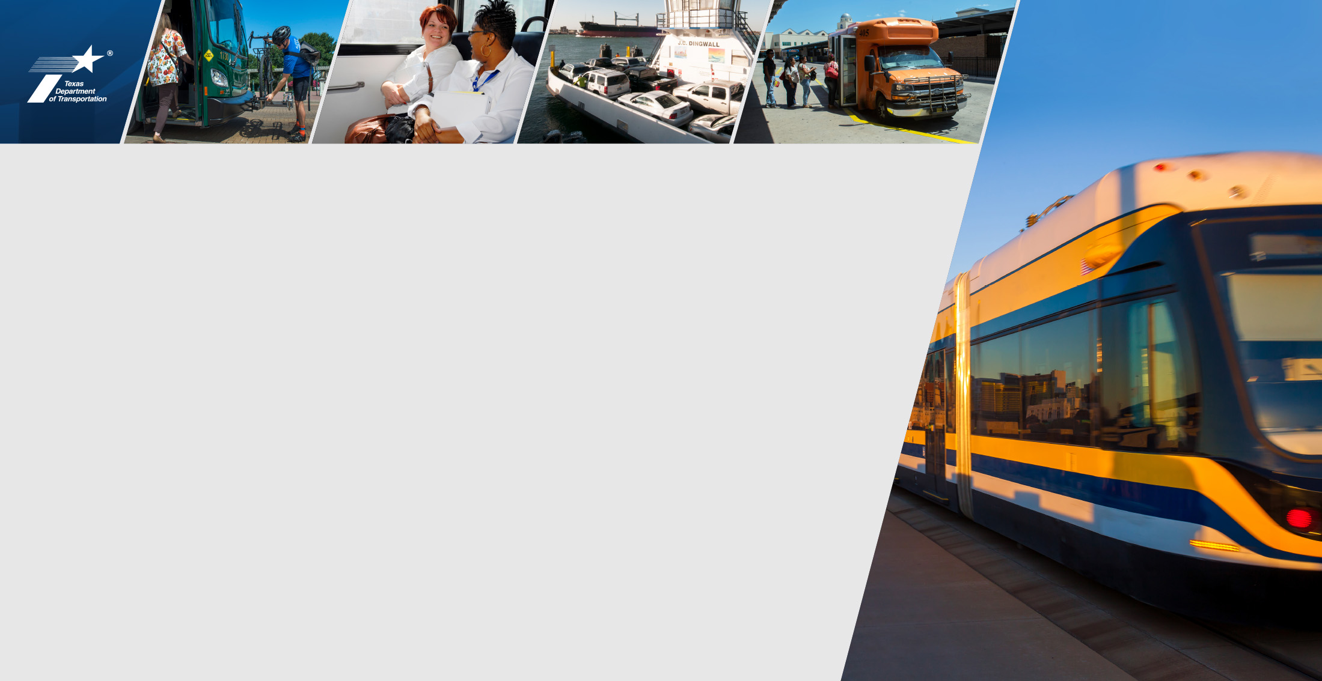
Questions
Caroline A. Mays, AICP
Director of Planning and Modal Programs
Texas Department of Transportation
Caroline.Mays@txdot.gov
(512) 658-2436

