Slide 1
Local Area Benefit/Cost Evaluation System
Brianne Glover
Senior Research Scientist

Slide 2
Model Background
This tool estimates property and sales tax impacts, primary and secondary employment figures, and regional economic activity impacts related to the construction and operation of prospective DART rail and bus rapid transit (BRT) stations
Originally created for DART in 2015
TTI collects and tracks sales and property tax data/rates through out the year and pushes it to the web model once or twice a year

Slide 3
Access LAB-CE Models
Begin Scenario Wizard Here

Slide 4
Scenario Wizard
Describe a Scenario
Land Use
Property Tax
Sales Tax
Additional Sub-Models that are not part of the Scenario Wizard:
Economic Impacts
Traveler Impacts (BCA)
Development Model
Notes:
The Scenario Wizard allows you to enter parameters concerning your proposed project. Once you select “Begin Here,” a page appears that allows you to enter scenario parameters of the proposed new station project. You will navigate through the following pages to enter estimates specific to your project:
• describe a scenario;
• land use;
• property tax; and
• sales tax.
Once you have navigated through these pages, you will see a summary page that presents an overview of the estimated project costs and benefits to your proposed project.

Slide 5
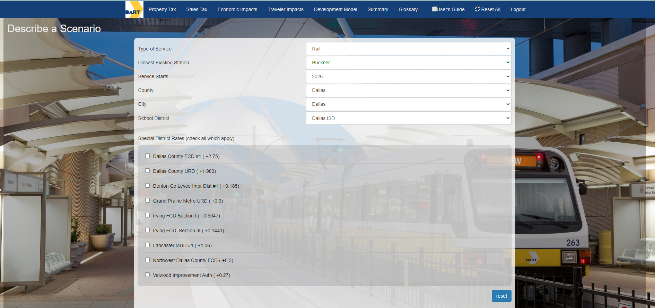
Notes:
The type of service is light rail, bus rapid transit, or streetcar. These three levels of service have different capital and maintenance costs; therefore, the expected benefits are different. The closest station input is used to assist in calculating the traveler impacts. The service start date is the year the construction is completed and service begins. This is when the benefits will start accruing.
Once the type of service is selected, the user can select the county and city of their choice. The cities and counties that are available to choose include those with existing service as well as major outlying cities that abut current service areas. Some cities with extremely small populations were not included. Selecting this will automatically populate available school district options. (Please note: many city boundaries overlap with several county and school district boundaries, so users will need to be aware of the boundaries within which a potential station would fall.)
The county, city, and school district are important in determining the tax impacts. Tax rates and growth patterns vary across the region, so you should be as specific as possible in selecting these entities. They should correspond to the expected location of the station.
As the user selects a county, only the cities within that county will be populated in the city menu. The same is true for the school district that is selected. Once the county and city are selected, the school district menu is populated with only those school districts within the previously selected jurisdictions.

Slide 6
Notes:
In some cases, special taxing districts may be applicable. Special taxing districts are independent governmental units that exist separately from general purpose local governments. These taxing districts can be used to fund special services in an area, such as ambulatory services or utility services and can raise revenue by taxation, special assessment, or charges for services provided. You may select whether you wish to have that rate apply in the model.

Slide 7
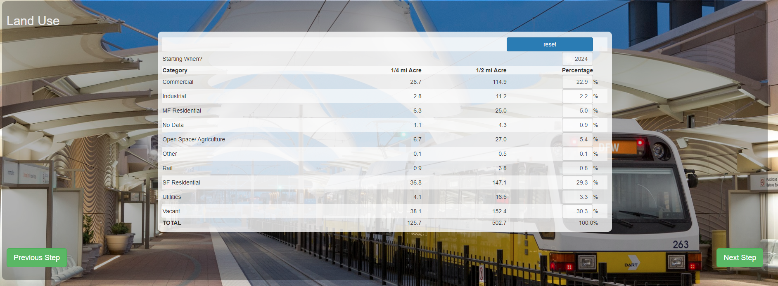
Notes:
The next page on the Scenario Wizard is the Land Use Page. What the user first sees is the acreage by land use type in the ¼ and ½ mile radius around the proposed station and the percentage of the total that it comprises. Here, you will be able to select whether they would like to change the land use type and which calendar year those changes to begin. This is a one-time change that the model allows to take place.
The default values that are populated in the model are the current land use type percentages based on the jurisdiction the user selected on the “Describe a Scenario” page. These are the land-use percentages for the city selected.
As new stations are announced and eventually constructed, the use of surrounding land will typically experience some degree of change. The Land Use Page presents default percentages based on current land uses within the previously chosen city. However, users may change the percentages to reflect anticipated changes resulting from station construction. It would be expected that these changes would take place in the commercial and multi-family land use categories providing for denser development surrounding the station.
It is of the utmost importance to notice both the operation start date and the land use changes start date.
• Operation Start Date: the year during which the DART station opens and is fully operational;
• Land Use Changes Start Date: the year during which land uses surrounding a station actually begin to reflect the effects of the new station opening.
Please be aware that land use changes typically do not occur rapidly, especially in areas where rezoning and other governmental approval is needed. It may also take time for an area to experience more multifamily and commercial development as people realize the benefits of proximity to transit. Therefore, it is recommended that you enter dates that are reasonable and take into account local situations that may impact time needed to see change.

Slide 8
Notes:
Below the initial scenario selection options are four more specifically transit and growth-related variables you are required to provide for your project. These are:
• approximate miles to connecting station;
• annual ridership at new station;
• discount rate; and
• travel growth rate.
These sliders allow you to change relevant assumptions in the model. The approximate distance to a connecting station, annual new ridership, the discount rate, and travel growth rate are all assumptions that can greatly affect the model outputs. If you are unsure about the ways in which these assumptions might affect your model outputs, it is recommended that you save your results and run this model again with the desired changes to your assumptions. This will allow you to see how changing these assumptions might affect your final output numbers.

Slide 9
Notes:
This Wizard page allows the user to adjust property tax growth rate assumptions. Because the benefits of any infrastructure investment can depend heavily on growth assumptions, the model user is also given the ability to adjust those growth rates. The default growth rates in the model are based on both historical growth patterns in the city selected and case studies involving property values surrounding six current DART stations. By using the mouse, the user can slide the cursor to the left or right as desired to adjust each model assumption.
Annual Average Land Value Growth Rate without Station: represents the rate at which land surrounding a potential station would appreciate in value annually if no station were constructed.
• Annual Average Land Value Growth Rate with Station: reflects the rate at which land surrounding a potential station would grow in value annually if a station were to be constructed.
• One Time Change in Land Value due to New Service (station announced): represents the initial, one time increase in property values within a quarter- or half-mile radius of the new station when the station is announced (but before the station is constructed.)
• One Time Change in Land Value due to New Service (service begins): represents the initial, one time increase in property values within a quarter- or half-mile radius of the new station once service begins.
Land values may begin to appreciate considerably in an area when a new station is announced, even if construction on the station begins much later. These values are also affected by zoning restrictions and other governmental decisions that may spur or impede development and thereby land value.

Slide 10
Notes:
This Wizard page allows the user to provide “Cost of Service” information and adjust sales tax growth rate assumptions. The first line the users see is any 4A and 4B tax revenue that the city currently has. It will show both the rate and the dollar amount. If the city does not have 4A or 4B tax revenue, it is shown as zero. Below this is a box for the user to provide their own “Cost of Service” estimate. This will be the cost used in performing the benefit/cost analysis.
The “Cost of Service” percentage refers to the amount of a city’s taxable retail sales. It is framed this way because current funding models for DART are based off of sales tax revenues. The model allows the user to either enter in a percentage or a fixed amount. Checking the box next to “Fixed Cost” changes the unit analysis to the right of the “Cost of Service” field from a “%” to a “M,” indicating a fixed dollar amount in millions. This allows the user to enter in a fixed amount rather than a percentage value.
Regardless of funding mechanism, this approach can be used to arrive at a variety of costs to be used in this analysis. Familiarity with the city’s taxable retail sales are required to do so. Knowing the city’s taxable retail sales will allow a particular funding level to be used.
Because the benefits of any infrastructure investment can depend heavily on growth assumptions, the model user is also given the ability to verify, and if necessary, adjust these growth rate assumptions. The default growth rates in the model are based on historic patterns and case study research that supports standard growth in sales, inflation, and average additional sales growth due to transit stations. By using the mouse, the user can slide the cursor to the left or right as desired to adjust each model assumption, as shown below. Inputs can be reset to default rates by using the “Reset to Defaults” button.
The user is also able to access the historical sales tax revenue and growth rates for the selected city. By clicking on the “show historical sales tax growth rates” link, the user is able to see tax revenue data going back to 2003. This will help the user formulate appropriate inputs for their scenario.

Slide 11
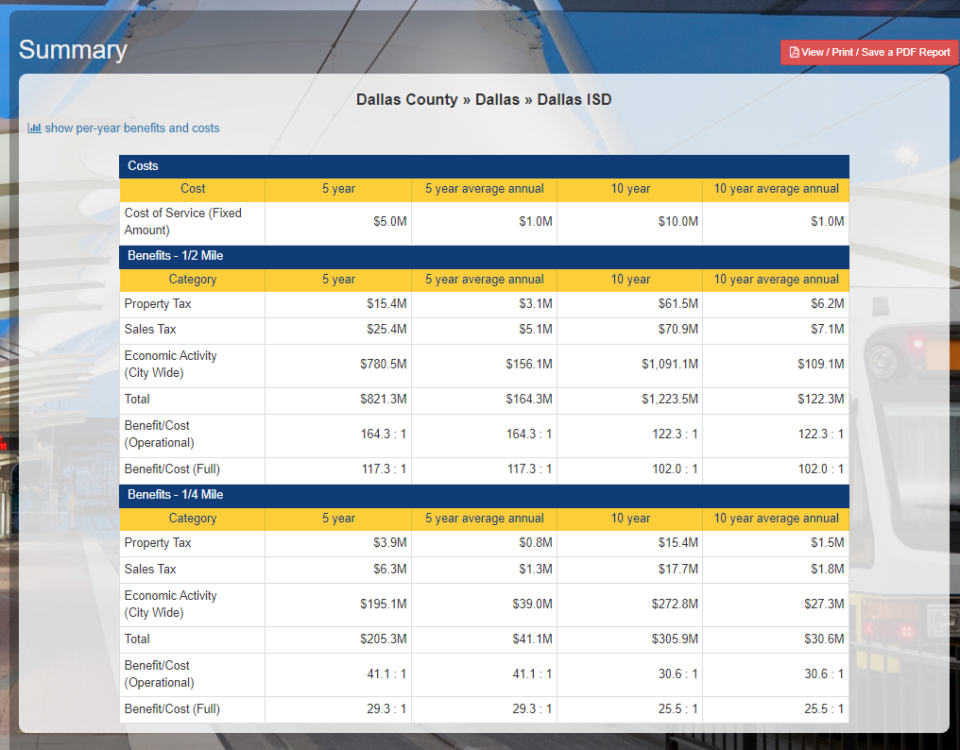
EXAMPLE ONLY
Notes:
The summary page provides an overview of the estimated project costs for the service selected and the estimated benefits and compares them. Both the costs and benefits are presented through a five- and ten-year perspective, along with the respective average annual impacts for property tax, sales tax, and economic activity. The cost is shown in terms of the cost of service value that the user entered in the model wizard.
Benefits shown within the summary page include increased property and sales tax revenues along with city-wide economic activity.
As transit options increase and associated development occurs, more money is likely to be spent in these surrounding shops, resulting in increased local and state sales tax receipts. Developers may also begin constructing new commercial, multifamily, office, and other structures that draw traffic and increase property values, which results in greater sales and property tax revenues. As residents and developers draw closer to new transit centers, new businesses may follow and old businesses may experience more customers and a greater employee applicant pool, resulting in greater economic activity.
The aforementioned benefits are considered both within ½ and ¼ mile of the proposed new station. Depending on the particular city, benefits may be more concentrated or dispersed. Again, specific station case study analysis was used to shape these considerations.
Once completing the initial Describe a Scenario portion of the model and reviewing the summary, the user can go back through the individual model pages or tabs at the top of the page and change any input data to see how different results may be achieved.

Slide 12
Property Tax Model

Slide 13
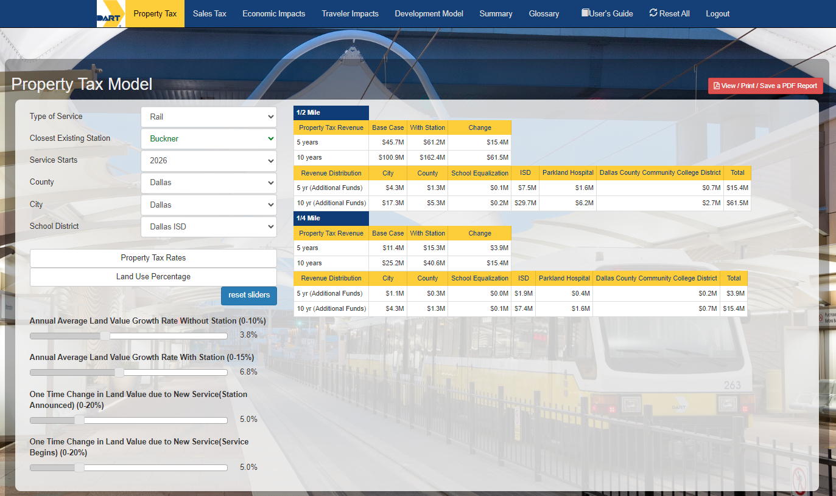
EXAMPLE ONLY
Notes:
This model page presents the model output relating to property tax impacts in greater detail than the summary page. It also allows you to make specific changes to any property tax rate and land use percentage assumptions. You can make adjustments to the property tax rate assumptions by clicking on the Property Tax Rates button.
The left side of this page also presents variables that were introduced during the scenario wizard, but now may be changed and immediately reflected on the right side of the page within the chart. For example, you can change service start dates, land value growth rates, and other variables. All changes will be presented in both ¼ and ½ mile perspectives.
In addition to property tax rate changes, you can also make land use percentage assumption changes. When you click on the land use percentage tab, a drop-down menu will appear that will allow you to enter in a starting year and make changes to the estimated land use percentage assumptions

Slide 14
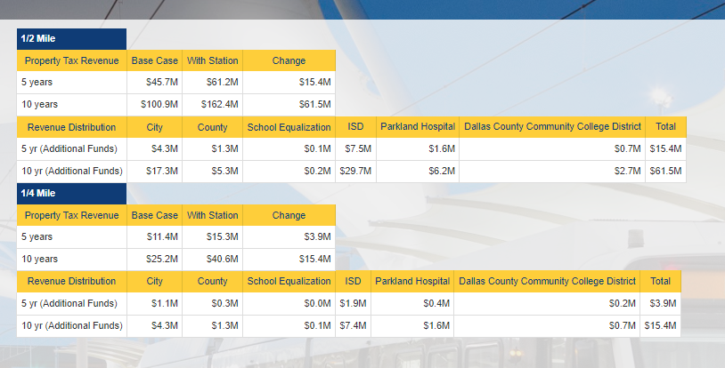
EXAMPLE ONLY
Notes:
The property tax revenue shown is distributed according to taxing entity so each authority can see the impacts to its organization. The tax impacts associated with the station development are under the “Change” category. The “Base Case” is what one would expect the tax revenue to be if the station was not built. The “With Station” column represents the tax revenue expected with the station as defined by the user. The change is the tax revenue attributed to the development of the station at that location.

Slide 15
Sales and Use Tax Model

Slide 16
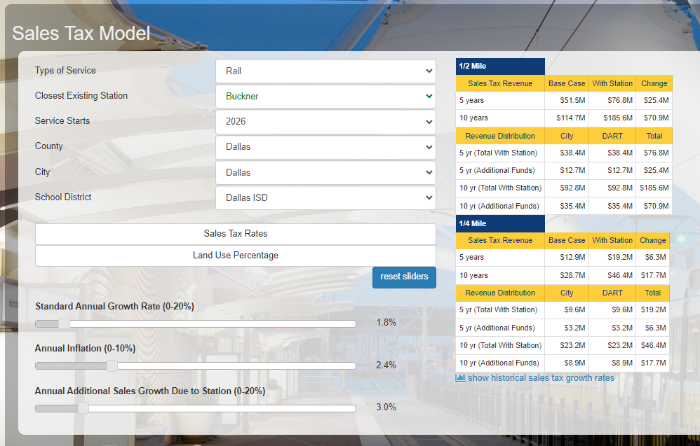
EXAMPLE ONLY
Notes:
This model page presents the model output relating to sales and use tax impacts in greater detail than the summary page. It also allows you to make specific changes to any sales and use tax rate and land use percentage assumptions.
You can make adjustments to the sales tax rates and land use selections on the left hand side of this page.

Slide 17
Economic Impacts Model

Slide 18
EXAMPLE ONLY
Notes:
The economic impacts page presents the economic impact results over a 10-year period ½ and ¼ mile from the proposed station. These impacts are derived from TTI’s in-house economic impact model. The model works as a typical Input/Output model using retail sales as the input. The estimated impacts included in the model are:
• Retail sales revenue;
• Number of jobs created both directly within the retail sector and indirectly economy wide;
• Personal income changes; and
• General economic activity.
The inputs needed to calculate these economic impacts are provided to the model in the course of using the wizard. They are based off the selected city’s retail sales numbers (gross sales) and the expected growth rates that the user selects for the model.
The impacts are noted over a 10-year period and are in terms of retail sales, number of jobs, personal income, and economic activity. The number of jobs is reported in full-time equivalent jobs although realistically many part-time jobs may be created. These can differ by industry and the impacts calculated here are specific to retail sales.

Slide 19
Traveler Impacts Model

Slide 20
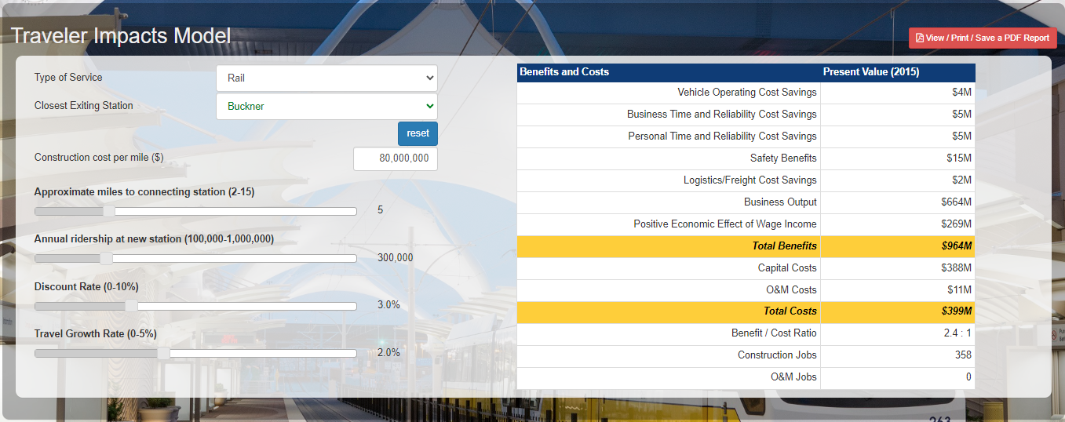
EXAMPLE ONLY
Notes:
The traveler impacts model page presents a detailed summary of the benefits and costs of the proposed station development project.
As with the Economic Impact Model, the Traveler Impact Model provides estimates based on the user’s input using the Wizard and default estimates for construction and maintenance costs. However, unlike the Economic Impact Model page, the user can make changes on the Traveler Impacts Model page. The user can change the type of service and location as well as the construction cost per mile.
The user is also able to make changes to the other variables that are included in this model which include distance to the connecting station, annual ridership, the discount rate, and the traveler growth rate.

Slide 21
Development Model

Slide 22
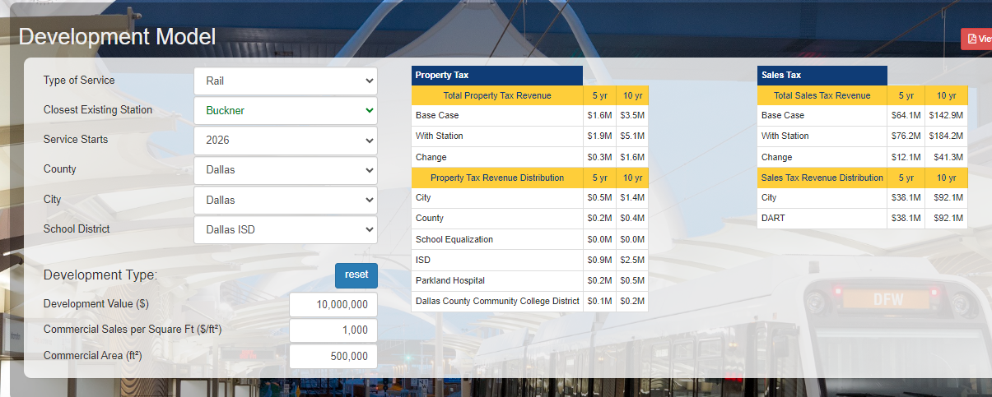
EXAMPLE ONLY
Notes:
The Development Model page allows users to assess the property and sales tax impacts associated with a specific development. It is not tied into the main model but is a separate calculation that allows users to estimate the property and sales tax revenues for a particular development in a particular location.
This model provides an opportunity for users to better understand what a development means to their community. Using the drop down menus, you can select the location – county, city, school district – along with total value of the development and the square footage of the commercial space.
This model centers on the total property value and sales tax revenues associated with a particular development. Users should be sure to include the total value of the development. For example, if the development is mixed use and includes both commercial space and multi-family housing, the value of both should be included.
The sales tax impacts are derived from the commercial space at the development. The model provides a default revenue per square foot value but allows the user to change it to accommodate specific types of retail establishments. Retail sales vary by type of business and location. Local understanding of this value will provide more accurate estimates to the users.

Slide 23
Conclusion
Similar model could be used to look at existing stations- allow for “what if” analyses using historical data.
Development Model is a standalone model
BCA/Traveler Impacts could be revisited periodically as costs change
Background data needs to be updated on a continual basis

Slide 24
Brianne Glover
B-glover@tti.tamu.edu

